Slide 1
Occupational Health Risk Registers
An effective communication and management tool.
19 May 2012 Prof. Cas J Badenhorst
Group Occupational Hygiene Specialist

Slide 2

The world is changing……..

Slide 3

and South Africa……

Slide 4
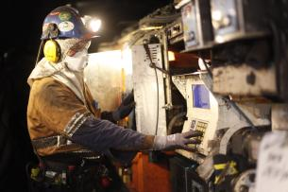
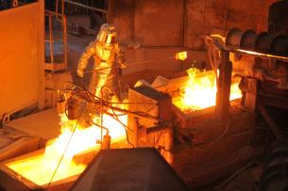
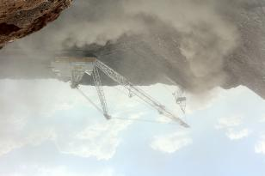
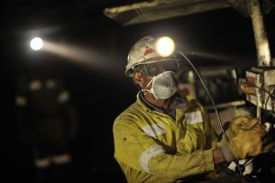
Primary aim
Prevent harm to employees
Prevent regulatory action against the Company
Minimise the risk of legal claims against the company for
occupational diseases, injuries and deaths
Minimise reputational risk

Slide 5

10 reasons for poor Occupational Health performance
Lack of commitment
Poor
awareness
Weak
hazard ID
Low hazard understanding
Systems
reactive
Inadequate resources
Inadequate liason between teams
Poor record keeping
Lagging
results
Unreliable sampling

Slide 6
The risk management process
1 Communication and consultation
2
Establishing the context
7
Monitoring and review
Risk assessment
3
Risk identification
4
Risk analysis
5
Risk evaluation
6
Risk treatment

Slide 7
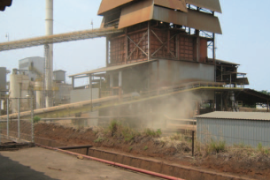
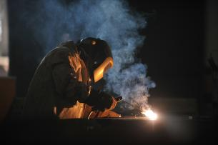
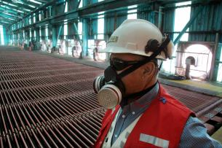
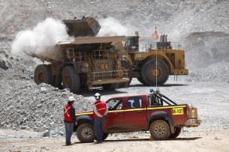
Adopted approach
Prevent harm to employees by:
Proactively identifying and managing sources of potential risk, and
Eliminating exposure to hazards

Slide 8
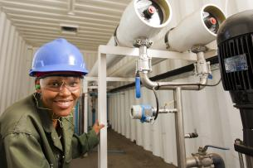
Best Practice
Knowing the hazard (anticipating and identifying).
Understanding the risk (quantifying).
Managing the risk (control at source, elimination, substitution, process change etc.)
Monitoring (occupational hygiene programmes, medical surveillance)
Review (audit, management review)
Continuous improvement

Slide 9
Key Questions for Managers
“HEALTH IN ACTION”
Do you Understand the Health Risks in your operation ?
  What are the health hazards in your operation
  What have you done to measure and assess the risks
Are you comfortable with the Control of health risks?
  What have you done to control health risks
  Do you monitor the effectiveness of your controls
Can you do More ?
  Have you optimised the control of health risks

Slide 10

What will change the effectiveness of Health Risk Management ?
Demystify health for managers
  Managing occupational health risk is an engineering problem
  Managing occupational disease is a medical problem
Focus on proactive engineering and operational control solutions
rather than reactive health and occ. hygiene risk management solutions
Move away from legal compliance as the only objective
Capitalise on existing safety management systems
It is wrong to protect with PPE and then use medical surveillance to measure our success or failure Occupational medicine and hygiene as disciplines are not the “silver bullet”
Notes:
We should recognise that health risks have an engineering origin and should have an “engineering” solution.

Slide 11
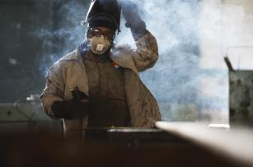
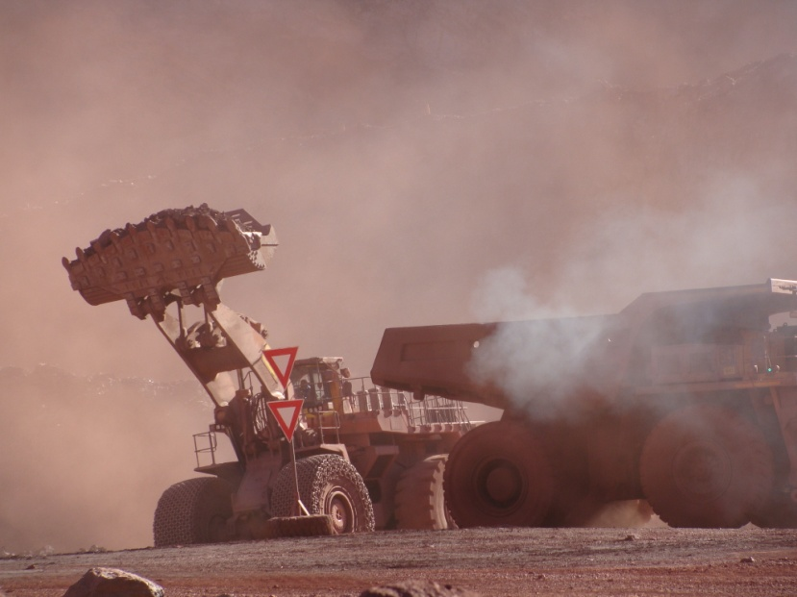
Do we understand the Health Risks?
- What is in the dust?
- Chemical composition
- Physical size and form of the particulates
- How much? For how long?
- Synergistic effects of combined exposures to
different pollutants
  What have been done to measure and assess the risks?
Who is exposed?
Can the exposures be linked to individuals?\
and to their medical records?
What have been done to control and monitor
the identified health risks?
Have the control of health risks been optimised?

Slide 12
Base-line occupational health risk assessment
Health Improvement Plan
mostly qualitative
high level
“Priority unwanted events or workplace conditions”
Issue-based occupational health risk assessment
Health hazard matrix
Continuous occupational health risk assessment
Health hazard inventory
Bow-tie analysis
Health-WRAC
ID sources
routine monitoring
Quantify sources
Critical control register
ID critical controls
Quantitative exposure assessment

Slide 13
Base-line occupational health risk assessment

Slide 14
Expected outcomes
Base-line occupational health risk assessment
Action: Issue-based occupational health risk assessment
(incl. bow-tie analysis)
Action: Continuous occupational health risk assessment
(routine monitoring)
Only 3 possible outcomes with 2 actions!
Low exposure (<10% OEL)
Uncertain
Unacceptable exposure (> OEL)
Supervision
Do not need active control
Verify periodically
Control
Need active control to ensure exposure remains below OEL
Intervention
Need intervention to reduce exposure to below OEL
Extreme exposure
Safety risk

Slide 15
Base-line occ. health risk assessment INPUTS
Results from medical surveillance
Historical occupational hygiene measurements
Baseline occupational health risk assessment
Process maps
Material safety data sheets
Literature study
Geological information
Incident records & employee complaints
Current samples (bulk, area & personal)
Walk trough assessment

Slide 16
INPUTS – example
Process map
Mine A
24% Cu
15% Fe
15% S
25% SiO₂
214 ppm As
173 ppm Pb
Mine B
26% Cu
30% Fe
37% S
3% SiO₂
1063 ppm As
284 ppm Pb

Slide 17
INPUTS – example
Historical IH measurements

Slide 18
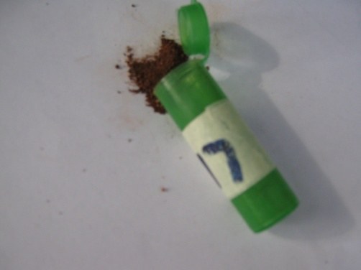
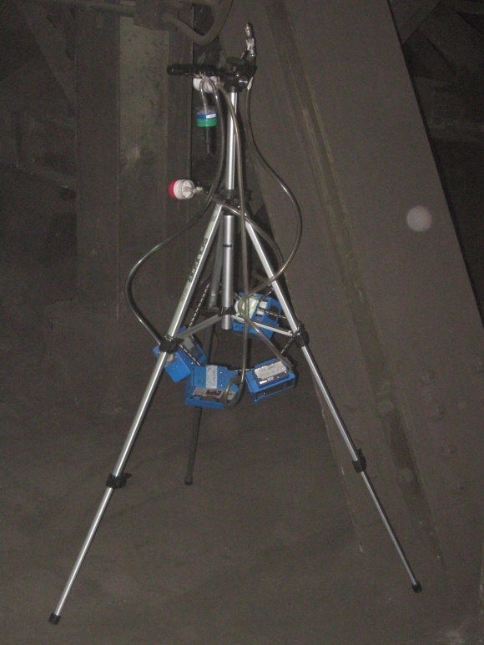
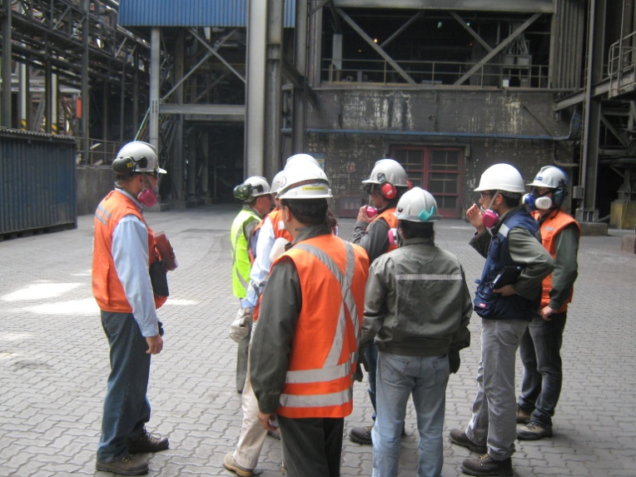
INPUTS – example
Dec 2011 – Walk- trough assessment
- Bulk samples
- Area samples

Slide 19
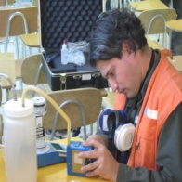
Base-line occ. health risk assessment OUTPUTS
Health hazard matrix (Health risk profile)
Health hazard inventory
Health-WRAC
Health hazard footprint
Workplace profile

Slide 20
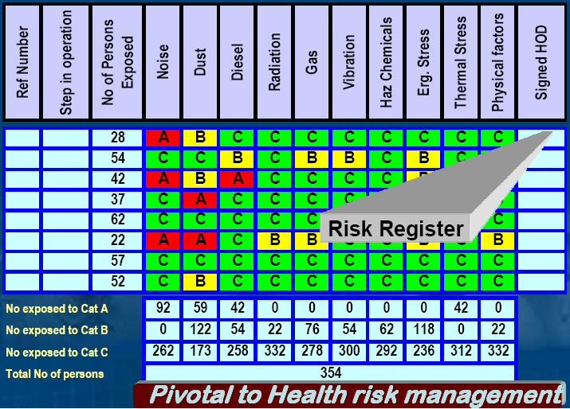
Simplify Health Risk Profile

Slide 21
Health hazard matrix (health risk profile)
Ref number | Step in operation | No of Persons Exposed | Inhalable hazards |  |  |  |  |  |  |  | Physical hazards |  |  |  | Ergonomics | Signed HOD
 |  |  | Respirable dust | SiO₂ | Lead | Arsenic | Mercury | Copper | SO₂ gas | CO gas | Noise | Heat stress | WBV | HAW | Ergonomic stress
1 | Concentrate & Flux storage |  | B | A | C | C | C | B | ? | ? |  | ? | ? | ? | ?
2 | Day Bins
3 | Steam dryer
4 | Dry Concentrate Bin
5 | Oxygen Plant
6 | Flash Furnace – Ground level
7 | Flash Furnace – Level 1
8 | Flash Furnace – Level 2 |  | B | A | C | C | C | B
9 | Flash Furnace – Level 3
10 | Flash Furnace – Level 4 |  | B | B | C | B | C | B
11 | Boiler section |  | B | B | C | C | C | C
12 | “WHB”
13 | Electrical Precipitators (“EP”) |  | C | C | C | A | C | C
14 | Converters
15 | Anode Furnace
16 | Casting Wheel
17 | Slag Furnace
18 | ES Slag Flotation
19 | Acid Plant
20 | Roving services
 | Front End Loader Operator |  | C | C | C | C | C | C
 | Road Sweeper Operator |  | B | A | C | C | C | C
 | Slag Dump Vehicle Operator
No exposed in Cat A
No exposed in Cat B
No exposed in Cat C
Total number of persons |  |  | xxx

Slide 22
Number of exposed persons
Inhalable hazards
Physical hazards
Ergonomic hazards
Bio-hazards
Health hazard matrix (health risk profile)
Ref number | Step in operation | No of Persons Exposed | Inhalable hazards |  |  |  |  |  |  |  | Physical hazards |  |  |  | Ergonomics | Signed HOD
 |  |  | Respirable dust | SiO₂ | Lead | Arsenic | Mercury | Copper | SO₂ gas | CO gas | Noise | Heat stress | WBV | HAW | Ergonomic stress
1 | Concentrate & Flux storage |  | B | A | C | C | C | B | ? | ? |  | ? | ? | ? | ?
2 | Day Bins
3 | Steam dryer
4 | Dry Concentrate Bin
5 | Oxygen Plant
6 | Flash Furnace – Ground level
7 | Flash Furnace – Level 1
8 | Flash Furnace – Level 2 |  | B | A | C | C | C | B
9 | Flash Furnace – Level 3
10 | Flash Furnace – Level 4 |  | B | B | C | B | C | B
11 | Boiler section |  | B | B | C | C | C | C
12 | “WHB”
13 | Electrical Precipitators (“EP”) |  | C | C | C | A | C | C
14 | Converters
15 | Anode Furnace
16 | Casting Wheel
17 | Slag Furnace
18 | ES Slag Flotation
19 | Acid Plant
20 | Roving services
 | Front End Loader Operator |  | C | C | C | C | C | C
 | Road Sweeper Operator |  | B | A | C | C | C | C
 | Slag Dump Vehicle Operator
No exposed in Cat A
No exposed in Cat B
No exposed in Cat C
Total number of persons |  |  | xxx
Step in process / area
Signature
(HOD/Area Sup)
Number of persons in Cat. A
Number of persons in Cat. B
Number of persons in Cat. C

Slide 23
Health hazard inventory
Ref number | Health hazard | Step or area in operation | Type of hazard | Nature of hazard | Route of entry | Frequency of exposure | Associated ill health effects | Source(s) of exposure
 | Respirable dust | Concentrate & flux storage Flash furnace Mobile equipment Boiler | Chemical stressor | Particulate | Inhalation | Daily, 4-8 hours | Respiratory irritation. Progressive Massive Fibrosis and Chronic Obstructive Airways Disease | Concentrate feed Furnace emissions
 | Respirable Crystalline Silica (RCS) | Concentrate & flux storage Flash furnace Mobile equipment Boiler | Chemical stressor | Particulate (crystal) | Inhalation | Daily, 4-8 hours | Cough, dyspnea (breathing difficulty), wheezing; decreased pulmonary function, progressive resp symptoms (silicosis); irritation eyes; [potential occupational carcinogen] | Concentrate feed Furnace emissions Flux
 | Arsenic (as arsenic in a solid form) | Off-gas treatment Flash furnace | Chemical stressor | Particulate | Inhalation Skin | Daily, 4-8 hours | Ulceration of nasal septum, dermatitis, gastrointestinal disturbances, peripheral neuropathy, resp irritation, hyperpigmentation of skin, [potential occupational carcinogen] | Concentrate feed Off-gas particulate collection system Furnace emissions
 | Arsenic (vapour form – arsenic trioxide) |  | Chemical stressor | Vapour
 | Lead | Concentrate handling, smelting and converting | Chemical stressor | Particulate | Inhalation | Infrequent | Lassitude (weakness, exhaustion), insomnia; facial pallor; anorexia, weight loss, malnutrition; constipation, abdominal pain, colic; anemia; gingival lead line; tremor; paralysis wrist, ankles; encephalopathy; kidney disease; irritation eyes; hypertension | Concentrate feed Furnace emissions
 | Mercury | Concentrate handling, smelting and converting | Chemical stressor | Vapour | Inhalation | Infrequent | Irritation eyes, skin; cough, chest pain, dyspnea (breathing difficulty), bronchitis, pneumonitis; tremor, insomnia, irritability, indecision, headache, lassitude (weakness, exhaustion); stomatitis, salivation; gastrointestinal disturbance, anorexia, weight loss; proteinuria | Concentrate feed Furnace emissions
 | Copper dust | Concentrate handling, smelting and converting | Chemical stressor | Particulate | Inhalation | Daily, 4-8 hours | Coughing, sneezing, runny nose, pulmonary fibrosis, and increased vascularity of the nasal mucosa. Possible liver damage. The carcinogenicity of copper has not been adequately studied. An increase in cancer risk has been found among copper smelters; however, the increased risk has been attributed to concomitant exposure to arsenic. | Concentrate feed Furnace emissions Concentrate feed Furnace emissions

Slide 24
Health hazard
Source(s) of exposure
Health hazard inventory
Ref number | Health hazard | Step or area in operation | Type of hazard | Nature of hazard | Route of entry | Frequency of exposure | Associated ill health effects | Source(s) of exposure
 | Respirable dust | Concentrate & flux storage Flash furnace Mobile equipment Boiler | Chemical stressor | Particulate | Inhalation | Daily, 4-8 hours | Respiratory irritation. Progressive Massive Fibrosis and Chronic Obstructive Airways Disease | Concentrate feed Furnace emissions
 | Respirable Crystalline Silica (RCS) | Concentrate & flux storage Flash furnace Mobile equipment Boiler | Chemical stressor | Particulate (crystal) | Inhalation | Daily, 4-8 hours | Cough, dyspnea (breathing difficulty), wheezing; decreased pulmonary function, progressive resp symptoms (silicosis); irritation eyes; [potential occupational carcinogen] | Concentrate feed Furnace emissions Flux
 | Arsenic (as arsenic in a solid form) | Off-gas treatment Flash furnace | Chemical stressor | Particulate | Inhalation Skin | Daily, 4-8 hours | Ulceration of nasal septum, dermatitis, gastrointestinal disturbances, peripheral neuropathy, resp irritation, hyperpigmentation of skin, [potential occupational carcinogen] | Concentrate feed Off-gas particulate collection system Furnace emissions
 | Arsenic (vapour form – arsenic trioxide) |  | Chemical stressor | Vapour
 | Lead | Concentrate handling, smelting and converting | Chemical stressor | Particulate | Inhalation | Infrequent | Lassitude (weakness, exhaustion), insomnia; facial pallor; anorexia, weight loss, malnutrition; constipation, abdominal pain, colic; anemia; gingival lead line; tremor; paralysis wrist, ankles; encephalopathy; kidney disease; irritation eyes; hypertension | Concentrate feed Furnace emissions
 | Mercury | Concentrate handling, smelting and converting | Chemical stressor | Vapour | Inhalation | Infrequent | Irritation eyes, skin; cough, chest pain, dyspnea (breathing difficulty), bronchitis, pneumonitis; tremor, insomnia, irritability, indecision, headache, lassitude (weakness, exhaustion); stomatitis, salivation; gastrointestinal disturbance, anorexia, weight loss; proteinuria | Concentrate feed Furnace emissions
 | Copper dust | Concentrate handling, smelting and converting | Chemical stressor | Particulate | Inhalation | Daily, 4-8 hours | Coughing, sneezing, runny nose, pulmonary fibrosis, and increased vascularity of the nasal mucosa. Possible liver damage. The carcinogenicity of copper has not been adequately studied. An increase in cancer risk has been found among copper smelters; however, the increased risk has been attributed to concomitant exposure to arsenic. | Concentrate feed Furnace emissions Concentrate feed Furnace emissions
Step in Operation / area
Type of health hazard
(chemical, physical, ergonomic, etc.)
Nature of health hazard
(particulate, gas, fume, etc.)
Associated ill health effects
Route of entry
(inhalation, ingestion or dermal))
Frequency of exposure

Slide 25
Baseline Health-WRAC
Ref number | Step in operation | Health hazard | No of Persons Exposed | Description of unwanted event / Consequence | Current controls | Likelihood | Consequence | Risk Rank | Health Risk Rank | Possible improvements or Additional Controls | Improvement or control targets | By Whom | By When
1 | Concentrator & Flux storage area | Resp. dust |  | Airborne conc. >50% of OEL |  | 4 | 2 | 12 | B Control
2 |  | Copper dust |  | Airborne conc. >50% of OEL |  | 4 | 2 | 12 | B Control
3 |  | RCS |  | Airborne conc. >OEL |  | 4 | 4 | 21 | A Intervene
4 | Flash Furnace – Level 2 | Resp. dust |  | Airborne conc. >50% of OEL |  | 4 | 2 | 12 | B Control
5 |  | Copper dust |  | Airborne conc. >50% of OEL |  | 4 | 2 | 12 | B Control
6 |  | RCS |  | Airborne conc. >OEL |  | 4 | 4 | 21 | A Intervene
7 | Flash Furnace – Level 4 | Resp. dust |  | Airborne conc. >50% of OEL |  | 4 | 2 | 12 | B Control
8 |  | Copper dust |  | Airborne conc. >50% of OEL |  | 4 | 2 | 12 | B Control
9 |  | Arsenic |  | Airborne conc. >50% of OEL |  | 4 | 2 | 12 | B Control
10 |  | RCS |  | Airborne conc. >50% of OEL |  | 4 | 2 | 12 | B Control
8 | Boiler Section (Level 2) | Resp.dust |  | Airborne conc. >50% of OEL |  | 4 | 2 | 12 | B Control
9 |  | RCS |  | Airborne conc. >50% of OEL |  | 4 | 2 | 12 | B Control
10 | Off-gas treatment Electrical Precipitators | Arsenic |  | Airborne conc. >OEL |  | 4 | 4 | 21 | A Intervene
11 | Roving Services Road Sweeper Operator | Resp.dust |  | Airborne conc. >50% of OEL |  | 4 | 2 | 12 | B Control
12 |  | RCS |  | Airborne conc. >OEL |  | 4 | 4 | 21 | A Intervene

Slide 26
Likelihood
Consequence
5x5 risk rank
Health risk rank
Baseline Health-WRAC
Step in process / area
By when
Ref number | Step in operation | Health hazard | No of Persons Exposed | Description of unwanted event / Consequence | Current controls | Likelihood | Consequence | Risk Rank | Health Risk Rank | Possible improvements or Additional Controls | Improvement or control targets | By Whom | By When
1 | Concentrator & Flux storage area | Resp. dust |  | Airborne conc. >50% of OEL |  | 4 | 2 | 12 | B Control
2 |  | Copper dust |  | Airborne conc. >50% of OEL |  | 4 | 2 | 12 | B Control
3 |  | RCS |  | Airborne conc. >OEL |  | 4 | 4 | 21 | A Intervene
4 | Flash Furnace – Level 2 | Resp. dust |  | Airborne conc. >50% of OEL |  | 4 | 2 | 12 | B Control
5 |  | Copper dust |  | Airborne conc. >50% of OEL |  | 4 | 2 | 12 | B Control
6 |  | RCS |  | Airborne conc. >OEL |  | 4 | 4 | 21 | A Intervene
7 | Flash Furnace – Level 4 | Resp. dust |  | Airborne conc. >50% of OEL |  | 4 | 2 | 12 | B Control
8 |  | Copper dust |  | Airborne conc. >50% of OEL |  | 4 | 2 | 12 | B Control
9 |  | Arsenic |  | Airborne conc. >50% of OEL |  | 4 | 2 | 12 | B Control
10 |  | RCS |  | Airborne conc. >50% of OEL |  | 4 | 2 | 12 | B Control
8 | Boiler Section (Level 2) | Resp.dust |  | Airborne conc. >50% of OEL |  | 4 | 2 | 12 | B Control
9 |  | RCS |  | Airborne conc. >50% of OEL |  | 4 | 2 | 12 | B Control
10 | Off-gas treatment Electrical Precipitators | Arsenic |  | Airborne conc. >OEL |  | 4 | 4 | 21 | A Intervene
11 | Roving Services Road Sweeper Operator | Resp.dust |  | Airborne conc. >50% of OEL |  | 4 | 2 | 12 | B Control
12 |  | RCS |  | Airborne conc. >OEL |  | 4 | 4 | 21 | A Intervene
Health hazard
Number of exposed persons
By whom
Description of unwanted event / Consequence
Additional controls
Current controls

Slide 27
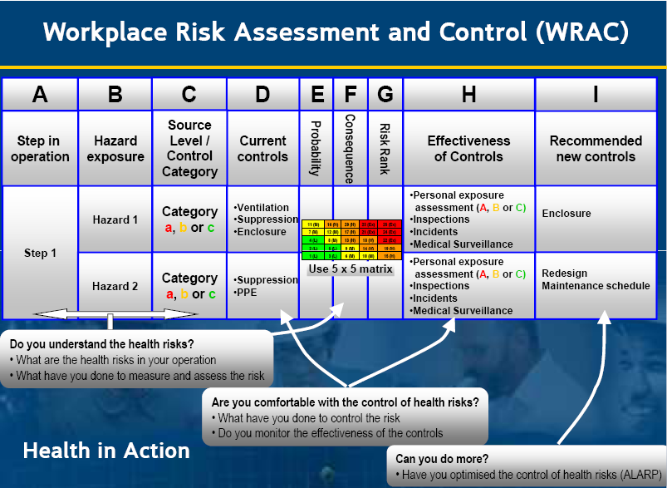
Workplace Risk Assessment and Control (WRAC)

Slide 28
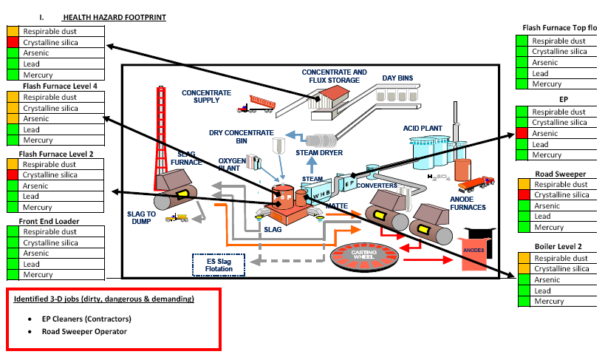
Health hazard footprint

Slide 29
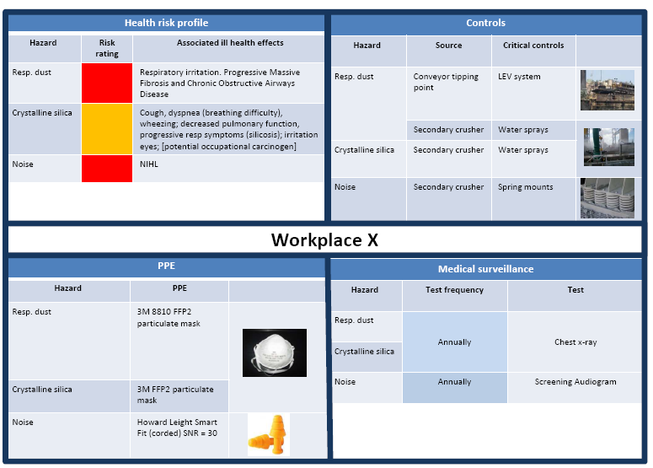
Workplace health risk profile

Slide 30
Issue-based occupational health risk assessment

Slide 31
Priority unwanted events or workplace conditions
Identify sources
Identify controls
Evaluate controls
Quantify sources
Quantitative personal exposure assessments
Critical control register
Bow-tie analysis
Health incidents

Slide 32
Health incidents
The traditional approach is to wait for the event and then work backwards to prevent the next case
Counting disease does not help to prevent the next case
You have to do something, but the cause is too remote in time
The top event is exposure
The policy is to prevent exposure at source
Health incidents provide a way of managing exposure in the present time rather than waiting for the health outcome
Health incidents provide a way of setting measurable targets in the present time for disease prevention through management of the cause
Managing controls is something managers and engineers can do and own

Slide 33
Unwanted Health Consequences
Occupational health incident
Working environment
Level 1 | Occupational hygiene measurements still acceptable, but adverse trends developing. (Repeated & validated measurements >0.5 OEL<OEL). Non-adherence to administrative control Failure to wear required PPE in a demarcated zone Employee complaint
Level 2 | Confirmed, out-of-control status by occupational hygiene measurement trends (Repeated & validated measurements >OEL) Occupational hygiene measurements outside of the expected, base-line parameters. A failure of an engineering control (e.g. failure of a dust suppression or chemical extraction system). Engineering control not performing to specifications Availability of engineering control < 50% of plant operation time Escalated L1 incident – work environment out of control with no attempt to address the situation.
 | An incident in which there is measurable but not permanent harm. Acute, treatable occupational disease e.g. dermatitis, tenosynovitis. Declines in medical surveillance parameters requiring temporary removal from exposure. E.g. blood lead. Travel related illness requiring medical treatment
Medicine
Level 3 | Incidents in which treatment is required and there is lost time but no permanent incapacity. Early occupational disease (without incapacity) resulting in job change without loss of income are counted here.
Level 4 | Occupational illness where there is measurable incapacity and which meets the Anglo American criteria for the diagnosis of occupational disease but the incapacity is not at a level for compensation. Occupational disease in which a job change has occurred and there is loss of income. The difference between level 3 and 4 here is the severity of the disease and the loss of income.
Level 5 | Compensatable occupational disease, disease resulting in medical retirement. Single or multiple deaths in service from occupational disease.

Slide 34
Use of incidents
Monitoring of controls
“Availability” of controls
Correction and reinstatement of controls within a suitable time frame
Learning
Leading indicator for health
Level 1 is the VFL of Health
Not for negative purposes
Everyone must be involved
Drive Behaviour change

Slide 35
Occupational hygiene programme template
Risk assessment
  Identification and quantification of sources
  Identification of who is exposed, when (what tasks) and how much
Education and training of employees
  The hazard
  How do you protect yourself
  What are the controls (what has management done to protect)
  Reporting of failures
Controls based on hierarchy
  Control at source
Monitoring and surveillance
  Monitoring of controls (are they working according to design)
  Monitoring of exposure
  Using incidents to help with monitoring
Learning from incidents
  Results used to correct failures and improve maintenance
  Results used to identify new risks

Slide 36
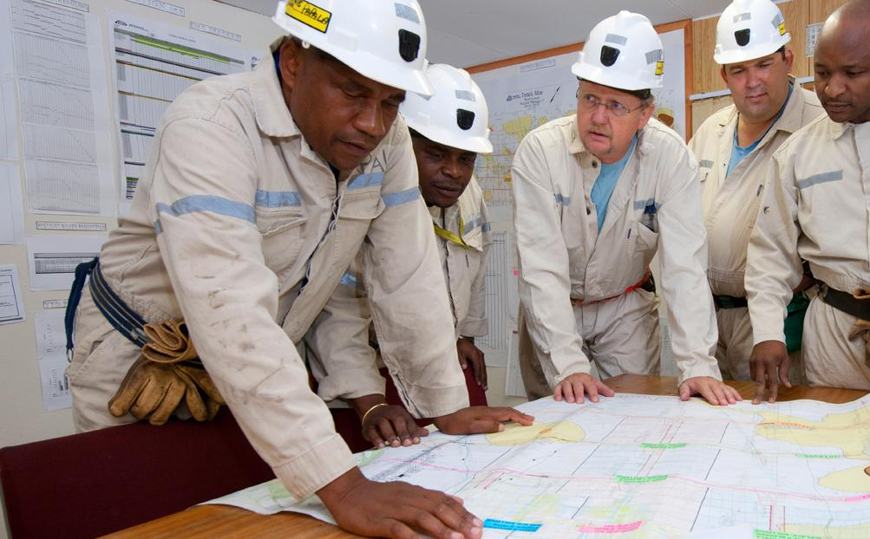
Responsibility and involvement
Management is responsible and accountable
Competent professionals engage in risk assessment, monitoring and control measures
Training by correct department
Everyone is involved in the process (a team effort to prevent harm)

Slide 37
The Risk Register
The WRAC is a useful way of doing this
Incorporate controls and assessment of effectiveness
Add future improvements
Forms the basis of the Health Improvement Plan
Summarised in a “risk map”

Slide 38
The WRAC in Action
Ref. #
Area or
Hazard
No of
Dose
Control
Where in
Step in process
Description of
Describe
Control
Control
Control
Indicators of
Recommended
Improvement
(HEG)
or Risk
persons
Category
Category
Control Map
map
Unwanted Event /
Current Control
Hierarchy
Effectivity
Category
Consequence
Likelihood
Ranking
loss of control
Action
Actions
By Whom
By When
Consequence
targets
C
c
1
1
1
1
Level 1
5
1
1
Workplace design
Elimination
Resilient
Routine
Insignificant
Almost certain
L
Measured
Intervention
(1 year)
B
b
2
2
2
2
Level 2
4
2
2
Hazard Risk Profile
Substitution
Comliance
Critical
Minor
Likely
M
Incidents
Exposure
(5 years)
reduction
A
a
3
3
3
Level 3
3
3
3
Community Disease
Eng Separation
Vulnerable
Moderate
Possible
H
Trends
Dose reduction
(10 years)
4
4
Level 4
2
4
4
Fit for work
Eng Reduce
Major
Unlikely
Ex
Reports
None
(20 years)
5
5
Level 5
1
Systems & Stds
Admin
Catastrophic
Rare
(+20 years)
6
6
Competence
PPE
7
7
Workplace Controls
None
8
Ilness Mitigation
Incidents linked to controls are used to manage controls day by day
Failures
Hygiene measurements
Medical surveillance
Targets and objectives can be set and measured

Slide 39
Thank you

