Slide 1

Critical components of a Fatigue Management Programme
Schu Schutte
Human Factors Research Group
CSIR Centre for Mining Innovation
MMPA 15th Annual Congress
18 May 2012

Slide 2
Fatigue – root cause of many accidents

Slide 3
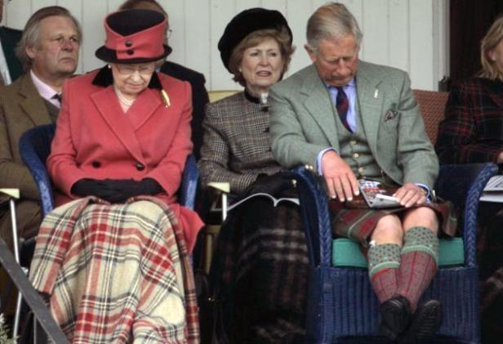
Notes:
Of course, some people don’t doze off on the job, they simply rest their eyes.
For some people resting their eyes for a little bit doesn’t matter, but for others, like your employees, it may be a life and death matter.

Slide 4

Outline of presentation
What is fatigue?
Is fatigue a risk in SA mines?
Why manage fatigue?
Causes of fatigue
Management of fatigue
Conclusions

Slide 5
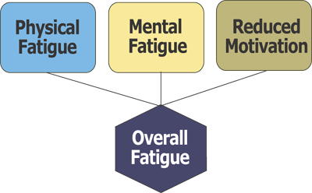
Definition of fatigue?
There is no single agreed definition of fatigue
“The term fatigue has been used in so many senses
that its application have become almost chaotic”
(Grandjean, 1980)

Slide 6
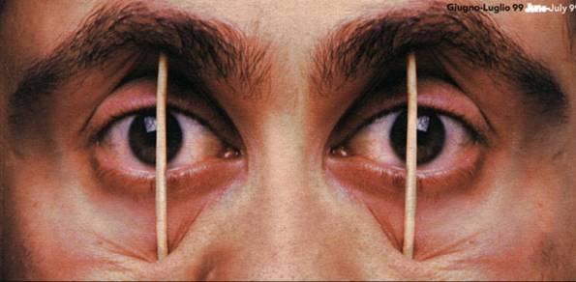
What do we mean by fatigue?
A state of perceived weariness that can result from prolonged working, heavy workload, insufficient rest and inadequate sleep
It involves a general feeling of tiredness, resulting in a reduced ability to perform work effectively
Fatigue can be either work or non-work related or a combination of both

Slide 7
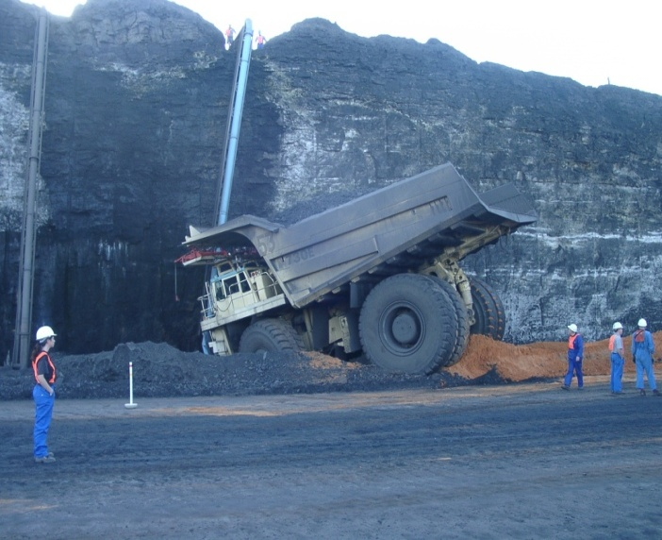

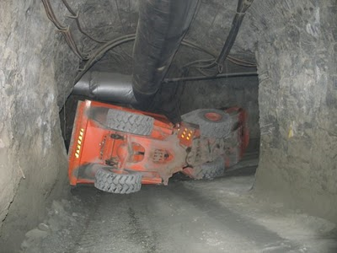
Fatigue problem in our mines?

Slide 8
Haul truck driver during night shift
Notes:
FEMALE; HAUL TRUCK

Slide 9
Haul truck driver (on ‘Alert’) during night shift

Slide 10
Fatigue risk associated with physical work in heat (WHO limit)

Slide 11
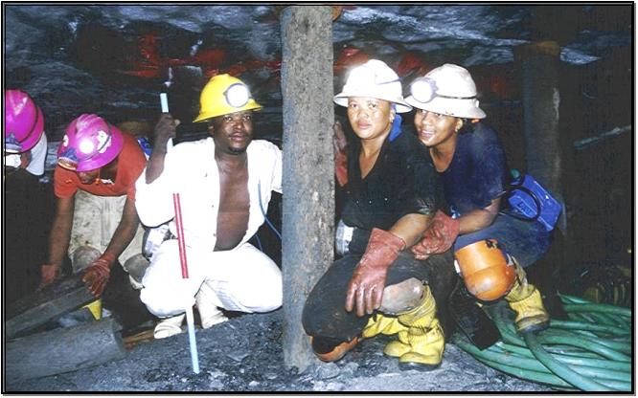
Risk of developing ‘physical fatigue’’
Gender | Heart rate (beats/min) | Core body temperature (◦C) | % of HR > 110 beats/min
Female | 121,9 ± 25,1* | 37,68 ± 0,37ºC* | 49%*
Male | 86,1 ± 22,4 | 37,24 ± 0,44ºC | 14%
* Significant difference from males

Slide 12
Why is managing fatigue important?
Failure to manage fatigue properly can have disastrous consequences
Fatigue increases the risk of accidents and incidents
Fatigue reduces productivity and morale, and increases absenteeism
The incidence of health problems such as sleep, gastrointestinal and cardiovascular disorders has been estimated to be greater in shift workers than day workers

Slide 13
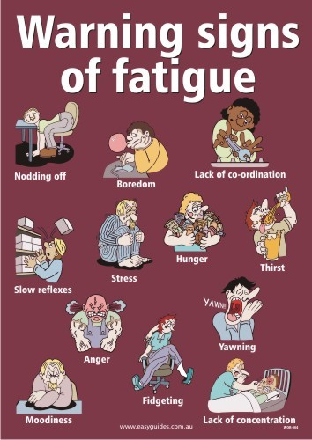
Causes of fatigue

Slide 14
Operator fatigue: key causal factors
F_{T} = F_{ss} + F_{ew} + F_{pf}
Where:
F_{T}: Total operator fatigue
F_{ss}: Fatigue related to shift system design (working time arrangements, circadian rhythm disruptions, sleep deprivation)
F_{ew}: Fatigue related to work and environmental factors (task requirements, physical work loads, workstation design, thermal stress)
F_{pf}: Fatigue related to operator’s personal factors (health status, nutritional status, social and domestic responsibilities)

Slide 15
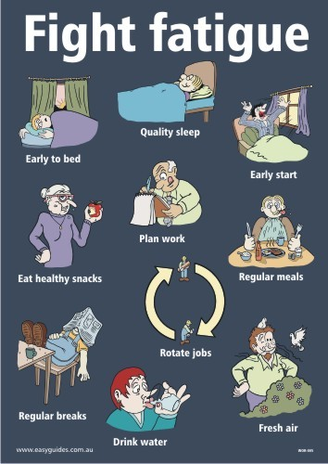
Fatigue management

Slide 16
Fatigue Management Programme (FMP)
Step 8: Evaluate FMP – aim for continuous improvement in the workplace
Step 7: Monitor FMP
Step 6: Implement FMP
Step 5: Increase awareness/training
Step 4: Develop FMP based on comprehensive approach
Step 3: Decide on control measures
Step 2: Assess the risk
Step 1: Identify factors contributing to fatigue

Slide 17
What is an ideal Fatigue Management Programme (FMP)?
A flexible, scientifically-based approach to managing risk associated with human fatigue in an organised manner appropriate to the level of risk exposure and the nature of the operation
There is no “one-size-fit-all” fatigue management approach
Be integrated with a safety management system
Documented and should exist within a ‘just’ safety culture

Slide 18
Fatigue management: general considerations
The best countermeasure to fatigue is sleep
In terms of fatigue management the managing of the opportunity to obtain sufficient sleep is as important as providing safe work procedures (Management)
Employees should make appropriate use of off-duty periods provided in the working pattern to obtain sufficient sleep to carry out their work safely, including taking future duty times into account when planning their off-duty lives
The management of fatigue is a shared responsibility between management and employees

Slide 19
Critical components to manage fatigue
F_{T} = F_{ss} + F_{ew} + F_{pf}
Optimal design of
shift system and rostering
Education and training
Sleep hygiene
Lifestyle interventions
Health screening
and counselling
Nutrition
Ergonomics interventions
taking abilities and
limitations of workers
into account

Slide 20
Components of FMP
Appropriate shift scheduling (assess risk using fatigue indices; create sufficient rest periods)
Education and training (at all levels, including families of shift workers)
Sleep management information (why, when and how to sleep – sleep hygiene)

Slide 21
Components of FMP
Assessment of employee fitness for work (identification of individuals at risk)
Medical advice (chronic conditions & medications)
Monitoring and review of FMP (incident investigations & feedback from employees)
Creating a “just” culture - part-way between a “blame” culture (where fear prevents open risk communication) and a “no-blame” culture (where sloppy practices and negligence tend to creep in)

Slide 22
Conclusions
Operator fatigue cannot be eliminated altogether, but can certainly be controlled
Fatigue can be limited by proper management and the involvement and active participation of all stakeholders
A holistic approach, based on best practices in terms of personal and business countermeasures, is required

Slide 23
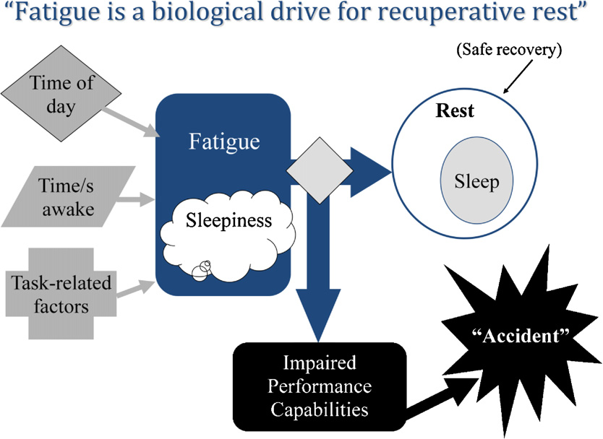
Conclusion

Slide 24

Thank you

Slide 25

Questions?
Notes:
25

