Slide 1


DUST TEAM
Up-date
L E A R N I N G H U B
by
Gerrie Pienaar and Dr Audrey Banyini
22 February 2013
CHAMBER OF MINES OF SOUTH AFRICA
Putting South Africa First

Slide 2





Contents
Understanding the problem
Clearing the air
Potential practices: up-date and
“New” potential practices
Challenges
Leading the change to zero harm

Slide 3
Mission and Values – MOSH Dust
Mission | To facilitate the adoption of leading practices through a people oriented process to significantly improve occupational health and safety in the minerals industry with specific focus on THE ELIMINATION OF SILICOSIS AND DUST RELATED DISEASES
Values | People | Zero harm to people is what we care about; it is our ultimate and continuing objective
 | Empathy | Demonstrated alignment with people’s values for safety and health and effective communication is our primary means to earning the confidence of employees and leadership credibility
 | Excellence | Goals and standards for our work will be consistent with the highest standards worldwide for safety and health performance
 | Involvement | Employees at all levels will be involved at the design, implementation and measurement of technologies and best practices that may effect them; it creates ownership and better assures success
Leading the change to zero harm

Slide 4
Eradication of Silicosis
Depends on:-
Company commitment to a Silicosis Prevention Programme
Identification of dust sources and employee dust exposures
Control of dust sources
Maintenance, examination and testing of the dust control systems
Employee involvement in the Silicosis Prevention Programme
Employee education and training
Administrative controls and work practices including the correct use of appropriate respiratory protection
Periodic medical surveillance
Auditing of the Silicosis Prevention Programme
Awareness / education
Filtration systems
Winch covers
etc
Then only we will Eradicate SILICOSIS
There is NO single practice
that will give us the desired outcome
Leading the change to zero harm

Slide 5
Understanding the problem
EXPOSURE TRENDS PER OCCUPATION (>0.05<0.1mg/m³)
Leading the change to zero harm

Slide 6
Identification of Potential Practices (clearing the air)
Process
MOSH
Involvement
R&D
Trial
Practice
  SIMRAC
  NIOSH
  GEE’s, Mine, supply chain etc.
  Mine
  Analyse results
  Desired outcome or not
  Leading or
  Simple Leading
SECTION 3.6
QAFS
AGA - Kopanang
Leading the change to zero harm

Slide 7
Up-date
Multi-stage filtration systems
Phakisa Mine – Harmony
To present to Learning Hub Head – SLP?
Winch cover
Beatrix Mine – Sibanye Gold
Prep. of docs to determine if qualifies as SLP
Development waterblast
Kopanang Mine – AGA
Require more installations
Fogger on CM’s
SASOL
Was discussed at the Colliery workshop - 15-02-13
Admin.
shift rotation
Rietvly Mine – XSTRATA
MOSHIAT-D decided to put on back burner
Leading the change to zero harm

Slide 8





New Identified Potential Practices
MOSHIAT-D : 16-01-13
Each one need to be investigated, then sorted according to risk and potential for adoption
Ref: doc 5
Dust Radar Screen
Health Room
Washing of shafts
Conveyor belt scraper
Haulage sprays
Washing of cars
Telescopic fogger/mist spray
Tip doors / covers
Dust mask testing
Leading the change to zero harm

Slide 9
New Identified Potential Practices - MOSHIAT-D : 16-01-13
LPAG – ref. Doc 5; sections: 3.6, 3.7 and 3.8
No | Potential Practice | Source organisation | State of application | Accessibility | Potential OHS impact | Risk addressed | Adoption potential
1 | Health room | Sibanye Gold | Demonstrated | Readily | Very High | Yes | Promising
2 | Washing of shafts | Sibanye Gold | Demonstrated | Readily | Moderate | Yes | Promising
3 | Washing of cars | Sibanye Gold | Demonstrated | Readily | Low | Yes | Poor
4 | Haulage sprays | Harmony and Sibanye Gold | Demonstrated | Readily | High | Yes | Promising
5 | Tip doors/covers | Harmony and Sibanye Gold | Demonstrated | Readily | Very High | Yes | Promising
6 | Dust mask testing | Sibanye Gold | Demonstrated | Readily | Low | Yes | Poor
7 | Telescopic mist spray | Harmony | Demonstrated | Readily | High | Yes | Promising
8 | Conveyor belt scraper | Harmony | Demonstrated | Readily | High | Yes | Promisisng
1
2
3
4
5
Key
1 | State of application: Field trial - Demonstrated - another country - one mine - multiple mines
2 | Accessibility: Readily - IP constraints - Commercial
3 | Potential impact: Very high - High - Moderate - Low - Very low
4 | Risk addressed: See WS#4, plus define as necessary
5 | Adoption potential: Promising - Poor
1
2
3
4
5
Leading the change to zero harm

Slide 10
New Identified Potential Practices - Collieries
MOSHIAT-D Collieries : 15-02-13
Each was investigated, then sorted according to risk and potential for adoption
Ref: doc 5
Dust Radar Screen
CM Foggers
Maintenance
Fixed R/T monitoring
Transfer points – spray config.
Collection bags for roofbolters
Intensive care protocol
Closing the loop incident reporting
MOR
Leading the change to zero harm

Slide 11
New Identified Potential Practices - MOSHIAT-D Collieries : 15-02-13
LPAG – ref. Doc 5; sections: 3.6, 3.7 and 3.8
No | Potential Practice | Source organisation | State of application | Accessibility | Potential OHS impact | Risk addressed | Adoption potential
1 | CM Foggers (Ug) | Sasol-Inus | Trial/demonstrated | IP constraint issues | Very High | Yes | Promising
2 | Maintenance (Ug/Surf) | Xstrata/ BHP-Errol/Tokkie | Demo | Ready | Very High | Yes | Promising
3 | Fixed R/T monitoring (Surf) | New Vaal –Andrew | Demo | Ready | Very High | Yes | Promising
4 | Transfer Points spray configuration (Ug/Surf) | Sasol-Inus | Demo | Ready | Very High | Yes | Promising
5 | Closing the loop incident reporting (Ug/Surf) | BHP (Klipspruit)-Tokkie | Demo | Ready | Moderate | Yes | Poor
6 | Collection bags for roof bolters (Ug) | Anglocoal(Greenside) –Anthony) | Demo | Ready | Moderate | Yes | Promising
7 | Intensive care protocol (Ug/Surf) | Sasol (Bossiespruit)-Inus | Demo | Ready | Moderate | Yes | Promising
8 | MOR (non-conformance logging) (Ug/Surf) | Sasol-Inus | Demo | Ready | Moderate | Yes | Poor
1
2
3
4
5
4
2
3
1
Key
1 | State of application: Field trial - Demonstrated - another country - one mine - multiple mines
2 | Accessibility: Readily - IP constraints - Commercial
3 | Potential impact: Very high - High - Moderate - Low - Very low
4 | Risk addressed: See WS#4, plus define as necessary
5 | Adoption potential: Promising - Poor
1
2
3
4
5
Leading the change to zero harm

Slide 12



Challenges
Implement
This is where it goes wrong
Adoption
V/S
I did it My Way
One man show
‘Maak ‘n Plan”
F A I L U R E
Address people issues
Multi-disciplinary
Maintain sustainability
S U C C E S S
YOU decide
Leading the change to zero harm

Slide 13
Challenges – cont.
No
Lowlights
(Issues, Risks, Concerns)
Response - Remedial Action
Due Date
Resp. Person
1
Monitoring improvement of implemented practices
A system need to be developed whereby adopters can report the outcome of implemented practices.
Next GEE’s
GP
AB
GEE’s
MOSHIAT-D
2
Financial risk on MOSH adoption system particularly health under the current climate.
Keep engaging with senior people to maintain interest – introduce “Moral Obligation” once approved
Ongoing
GP
AB
Champions
3
Lack of multi-disciplinary involvement at MOSHIAT-D and poor attendance at all scheduled meetings.
Keep engaging with senior people to ensure that multi-disciplinary teams are established at mine level and maintained – Task Force can assist
At every MOSHIAT-D and Task Force scheduled meeting
GP
AB
Task Force
4
Tracking of ALL adopters – current practices
Compile an up to date list of adopters
Mar 2013
GP
AB
Leading the change to zero harm

Slide 14
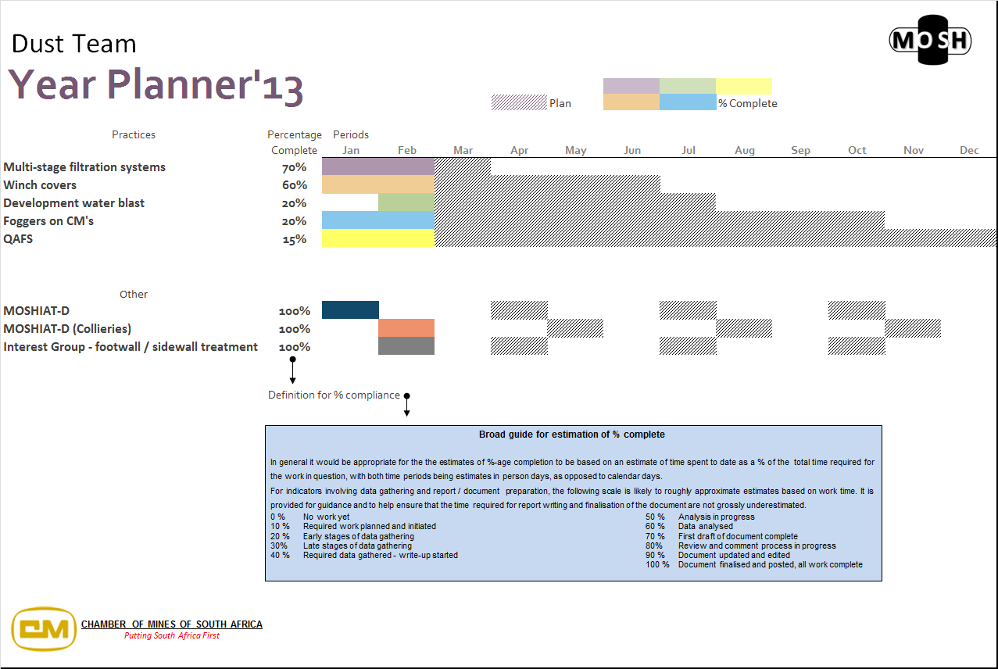

Slide 15

Closure
“together with the Mining Industry - we all need to get better at what we know is the right thing to do.”
G Briggs – Dust Sponsor - 2012
Thank you
Leading the change to zero harm

