Slide 1
Noise Team
22 February 2013

Slide 2

Contents
Progress
Lowlights
Highlights
Key lessons learnt

Slide 3
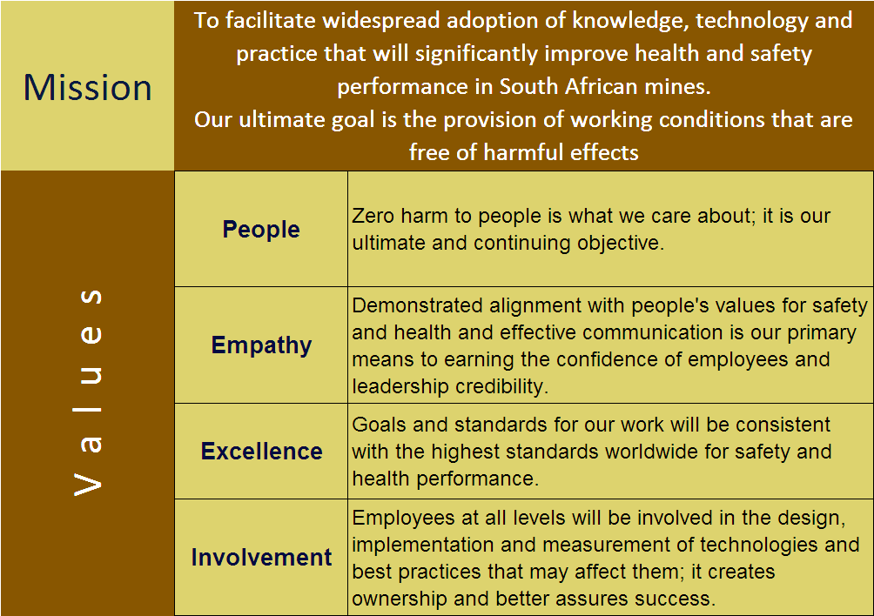
Mission and Values - MOSH
To facilitate the adoption of leading practice through a people oriented process to significantly improve occupational health and safety in the minerals industry
Our ultimate goal is the provision of working conditions that are free from harmful effects
Values
Leading the change to zero harm

Slide 4
Summary
HPD TAS Adoption
  Assisting 7 Mining Houses with the adoption
  Buy-in - Mining EXCO presentation
Source Elimination Repository
  Compiled USA noise control initiatives for Underground and Surface Mines
New leading Practice
  Part of the Strat. Plan Need - need to empower the team

Slide 5
Progress for the Month (Nov Dec ‘12)
No | Highlights (Achievements, Industry Interactions)
1 | 20 November 2012 – Noise Adoption Team weekly meeting
2 | 21 November 2012 – Xstrata Alloys Western Mines EXCO presentation-HPD_TAS_Adoption
3 | 22 November 2012 – Khutala PDS Visit
4 | 23 November 2012 – Limpopo/Eastern district Safety Managers Forum
5 | 27 November 2012 – Xstrata Alloys Western Mines Noise adoption team meeting
6 | 28 November 2012 – Exxaro EXCO presentation-HPD_TAS_Adoption
7 | 13 December 2012 – Wits university engagement (Noise research)
8 | 12 - 19 December 2012 – Harmony Road show (Integrating MOSH to Harmony KPI’s)
9 | 15-17 January 2013 - Noise Adoption Team strategic session
10 | 24 January 2013 – Xstrata Alloys Western Mines – Induction of mine adoption teams on HPD TAS Adoption
11 | 29 January 2013- Noise Adoption Team weekly meeting
Leading the change to zero harm

Slide 6
Progress for the Month ( Jan Feb ‘13)
No | Highlights (Achievements, Industry Interactions)
12 | 30 January 2013 – Sacepa meeting
13 | 31 January 2013 – Coal Safe Organising Committee attendance
14 | 05 February 2013 – Lonmin (Briefing session)
15 | 07 February 2013 – North West Tri-Partite forum meeting (Northam Cancellation)
16 | 08 February 2013 – GEE Meeting
17 | 11 February 2013 – ARM Nkomati – Induction of mine adoption teams on HPD TAS Adoption
18 | 12 February 2013 – ARM Two Rivers – Induction of mine adoption teams on HPD TAS Adoption
19 | 14 February 2013 – DMR Occupational Health Meeting
20
22
Leading the change to zero harm

Slide 7
Lowlights
No | Lowlights (Issues, Risks, Concerns) | Response - Remedial Action | Due Date | Resp. Person
1. | Northam Platinum adoption meeting cancelled-Short notice | Keep and file communication as proof | 08 Feb ‘13 | Team
2. | Cancelled meetings with Xstrata | Re scheduled training date (1/3/13) | 13 Mar ‘13 | Team
3. | Limited capacity of the behaviour specialist to conduct interviewee training | Progress delayed. Need to train the trainer or team managers | 20 Mar ‘13 | Team
4. | Realization that the team is not empowered enough to deal with NIHL prevention | To let deciders and stakeholders aware of this misalignment
5.
6.
7.
Leading the change to zero harm

Slide 8
Highlights
No | Highlights (Achievements, Industry Interactions)
23 | Progress to HPD_TAS Adoption i.e. Setting up of adoption teams, induction, agreeing on adoption plans for 7 mining houses (Xstrata, ARM, Exxarro, Sasol, Harmony, Impala and Northam)
24 | NIHL Prevention Strategic plan for the team
25 | Adding first world Noise source elimination initiatives to our source elimination repository USA
26
27
28
29
30
31
32
33
Leading the change to zero harm

