Slide 1



D U S T
Up-date
L E A R N I N G H U B
by
Gerrie Pienaar, Johan van Rensburg and Dr Audrey Banyini
15 August 2014
CHAMBER OF MINES OF SOUTH AFRICA
Putting South Africa First

Slide 2

Content
Mission and Values - Dust
Work in progress
SLP Progress report
Challenges
Leading the change to zero harm

Slide 3
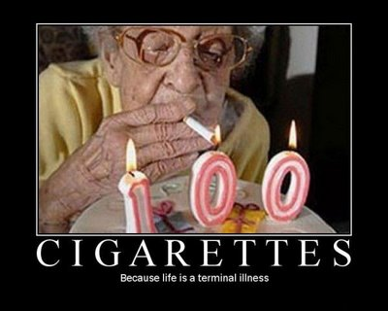

Think AGAIN??
Y o u G O G r a n n y
Leading the change to zero harm

Slide 4
Mission and Values – MOSH Dust
Mission | To facilitate the adoption of leading practices through a people orientated process to significantly improve occupational health and safety in the minerals industry with specific focus on THE ELIMINATION OF SILICOSIS AND DUST RELATED DISEASES
Values | People | Zero harm to people is what we care about; it is our ultimate and continuing objective
 | Empathy | Demonstrated alignment with people’s values for safety and health and effective communication is our primary means to earning the confidence of employees and leadership credibility
 | Excellence | Goals and standards for our work will be consistent with the highest standards worldwide for safety and health performance
 | Involvement | Employees at all levels will be involved at the design, implementation and measurement of technologies and best practices that may effect them; it creates ownership and better assures success
Leading the change to zero harm

Slide 5
Feedback
Work in progress
Development Waterblast
Kopanang Mine AGA
Candidate SLP – awaiting date for internal peer review
Telescopic Spray System
Kopanang Mine AGA
Candidate SLP – awaiting date for internal peer review
Realtime Monitoring (G)
Kopanang Mine AGA
Investigation and enquiries concluded – source mine report in progress
Realtime Monitoring (C)
New Vaal Colliery Anglo PLC
Candidate SLP – doc 51 to be reviewed by MOSHIAT-D Coal on 29-08-14
Leading the change to zero harm

Slide 6
SLP Progress Report
Winch Covers
NOTE:
This will again be discussed at the next scheduled meeting: 09-09-14
Leading the change to zero harm

Slide 7
SLP Adoption Tracker
Winch Covers
NOTE:
This will again be discussed at the next scheduled meeting: 09-09-14
Leading the change to zero harm

Slide 8
SLP Progress Report
Multi-stage Filtration System
NOTE:
This will again be discussed at the next scheduled meeting: 09-09-14
Leading the change to zero harm

Slide 9
SLP Adoption Tracker
Multi-stage Filtration
System
NOTE:
This will again be discussed at the next scheduled meeting: 09-09-14
Leading the change to zero harm

Slide 10
Challenges
Widespread adoption of current SLP’s (multi-stage filtration system and winch cover)
  Through the Interest Group ensure industry commitment
S U C C E S S
Adoption v/s implementation
  Assist industry in understanding the difference and also assist in the adoption process during Interest Group meetings
Leading the change to zero harm

Slide 11

For more information
contact the LEARNING HUB DUST TEAM
at
011 498 7100
GERRIE PIENAAR
gerriepienaar69@gmail.com
JOHAN van RENSBURG
johan.c.vanrensburg@angloamerican.com
Dr AUDREY BANYINI
ABanyini@chamberofmines.org.za
L E A R N I N G H U B

