Slide 1
MOSH Falls of Ground Team
Leading Practice
Adoption Team
Activity Report
17 April 2015

Slide 2

Contents
Mission and Values reminder
Progress January February 2015
Leading Practice Adoption
Activities
Challenges
Positives

Slide 3
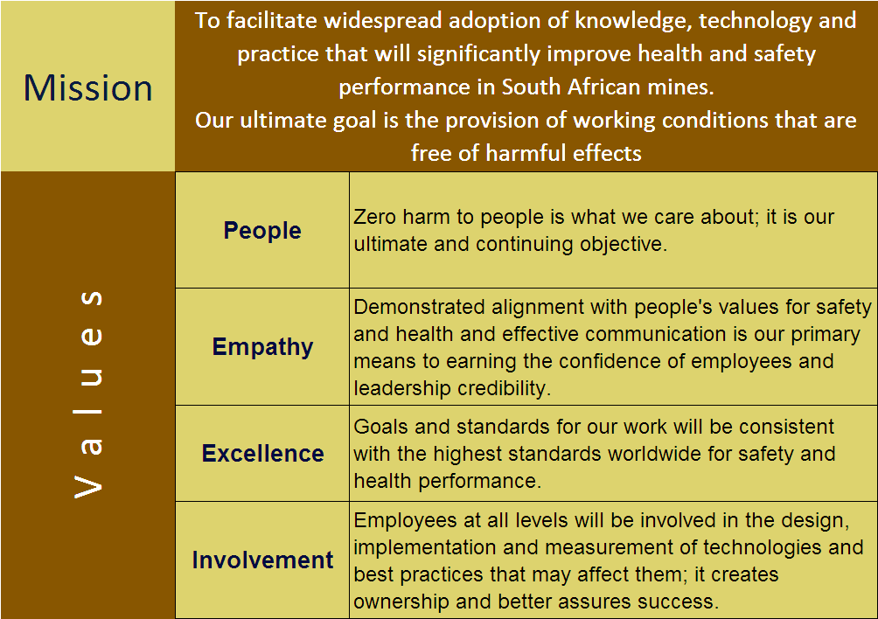
Mission and Values - MOSH
To facilitate the adoption of leading practice through a people oriented process to significantly improve occupational health and safety in the minerals industry
Our ultimate goal is the provision of working conditions that are free from harmful effects
Values
Leading the change to zero harm

Slide 4
Leading Practice Adoption
Leading Practice | Mines | % Adoption (Documents) | Portfolios of Adoption | No of Crews Trained | No of Persons Influenced
Entry Examination and Making Safe | Central 74 E/Limb 16 N/Cape 6 | 98% 95% 72% | 2 2 | 6990 694 160 | 71000 13880 3200
Bolts with Nets | Central 49 | 97% | 3 | 2531 | 30000
TARP (FoG) | Central 41 E/Limb 16 N/Cape 6 | 71% 66% 72% | 3 2 1 | 1444 395 280 | 27000 7900 560
Value Added Drilling and Blasting (Investigation Phase) | Position Paper drawn up and circulated to experts
“Ledging” (Investigation Phase) | Final meeting of expert team and meeting with Sponsor planned (15 April 2015 and 21 April 2015)
Leading the change to zero harm

Slide 5
Progress for the Month of March / April 2015
No` | Activities
1 | Tripartite forums visited and positively participated . (North West, Rustenburg). Engaged with Limpopo OH&H Working Group – MOSH Process and Emergency Preparedness
2 | MOSH FOG Industry Adoption Team – poor attendance at March meeting, DMR involvement Analysis of the Influence Diagram for FoG and its implications for future Leading practices Working on stimulation programmes for COPA’s and Adoption team meetings
3 | Special assistance to South Deep, Tau Tona, Kopanang, de Beers and Black Mountain with various FoG Leading Practices and assessments of progress with MOSH Leading Practices.
4 | COPA Meeting held in the Northern Cape. The next COPA in this region will be held at Wessels mine with an underground visit on 20 May. A next quarterly COPA meeting of the Eastern Limb will be held on 8 May at Twickenham Mine (with inclusion of AMMSA representatives). Central COPA held in Randfontein. Next COPA meeting 24 April.
5 | Position Paper on Value Added Drilling and Blasting processes finalised and circulated for expert comment
6 | Conducting investigative interviews on “Ledging” Expert committee met on 15 April Meeting with P Turner on 21 April to finalise preparation for feed back to CEO Elimination of Fatalities committee on 15 May 2015
7 | Help given to MHSC on running a day of learning on gas outbursts in Platinum mines – completed SIMRAC project
Leading the change to zero harm

Slide 6
Progress for the Month of March / April 20154
No | Challenge (Issues, Risks, Concerns) | Response - Remedial Action | Due Date | Resp. Person
1 | Maintaining value in COPA’s | Get Host Mine Managers to do Mine Presentations and overviews at COPA Meetings Underground visits to areas of successful Adoption Presentation of “Certificate of Adoption” by HoLH at TPF Meetings or AMMSA Meetings?? Following up on FoG related Section 54 Instructions | On-Going | Team
2 | Generating “New Leading Practices” for adoption | Working on Value Added Drilling and Blasting and Ledging with the view to rolling out to industry by way of “Day of Learning “/ Principles of Good Practice etc. | On-going | Team
3 | Working with “Lagging Mines” | Improve communications with MOSH Task Force Conducting visits to individual mines | On-going | DJA AvZ CL
Leading the change to zero harm

Slide 7
Developments
Issue | Action | TimeLine
Include Ledging in the MOSH FOG Adoption Team Scope | Information gathering Data on fatalities per square metre of hanging wall exposed collected Meetings with experts held and sponsor planned | Preliminary Report scheduled for end 2nd Quarter 2015
Team to conduct Mine Visits following FOG Fatalities | Fatalities and Learning Points are discussed at the MOSH FOG Industry Adoption Team Level | On-going
Tracking Documents should include No. Of People Influenced by Adopted Practice/s | Tracking Documents updated to include these figures, currently being updated | In progress
Tracking document to include % of mines experiencing FOG Problems | Research currently underway to quantify | May 2015
Leading the change to zero harm

Slide 8
Results of the Influence Diagram
Parameters | Level of Compliance to designs and standards | State of Mining Economics | Quality of Planning | Quality of Leadership at all levels | Amount of Face Time | Availability of human resources | Availability of other resources | Geological complexity | Change Management | Competence of people | Quality of Design | Quality and frequency of monitoring | Quality of drilling and blasting | Quality of Hazard identification | Extent of rock mass fracturing | Geopolitical influence | Count
Level of Compliance to designs and standards |  | y | y |  | y |  |  |  |  |  |  |  | y | y |  |  | 5
State of Mining Economics | y |  | y | y | y | y | y |  | y |  | y |  | y | y |  |  | 10
Quality of Planning | y | y |  |  | y | y | y |  | y |  | y | y | y | y | y |  | 11
Quality of Leadership at all levels | Y |  | y |  | y | y | y |  | y | y | y | y | y | Y |  | y | 12
Amount of Face Time | y | y |  |  |  |  |  |  |  |  |  | y | y | y |  |  | 5
Availability of human resources | y |  | y | y | y |  |  |  |  | y |  | y | y |  |  |  | 7
Availability of other resources | y | y | y |  | y |  |  |  |  |  |  |  | y | y |  |  | 6
Geological complexity | y | y | y |  | y |  |  |  |  |  | y | y | y | y | y |  | 9
Change Management(Behaviour) | y | y | y | y | y | y | y |  |  | y | y | y | y | y |  | y | 13
Competence of people | y |  | y | y | y | y | y |  | y |  | y | y | y | y |  |  | 11
Quality of Design | y | y |  |  | y |  |  |  |  |  |  | y | y |  | y |  | 6
Quality and frequency of monitoring | y |  | y |  |  |  |  |  |  |  |  |  | y | y |  |  | 4
Quality of drilling and blasting |  | y | y |  | y |  |  |  |  |  |  |  |  |  | y |  | 4
Quality of Hazard identification | y | y | y |  |  |  |  |  |  |  | y |  | y |  |  |  | 5
Extent of rock mass fracturing |  | y |  |  | y |  |  |  |  |  |  |  | y | y |  |  | 4
Geopolitical influence | y | y |  | y |  |  |  |  |  |  |  |  |  |  |  |  | 3
 | 13 | 11 | 11 | 5 | 12 | 5 | 5 | 0 | 4 | 3 | 7 | 8 | 14 | 11 | 4 | 2

Slide 9
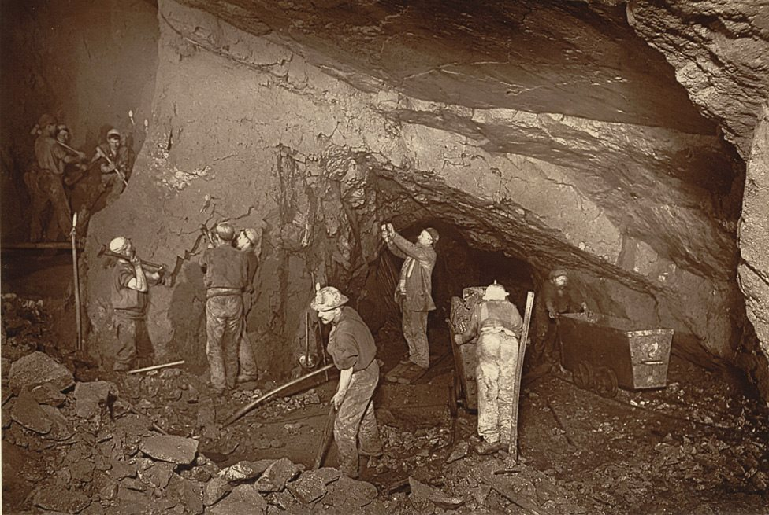
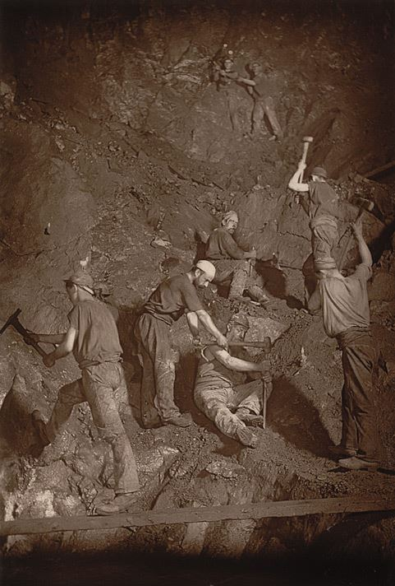
Questions or Discussion?
Leading the change to zero harm

