Slide 1


DUST TEAM u p - d a t e
April 2014 to date
by
Gerrie Pienaar, Johan Janse van Rensburg and Dr Audrey Banyini
13 May 2014
CHAMBER OF MINES OF SOUTH AFRICA
Putting South Africa First

Slide 2

Contents
Mission and values reminder
Progress update – key indicators
Highlights
Lowlights
Key lessons learnt
Leading the change to zero harm

Slide 3
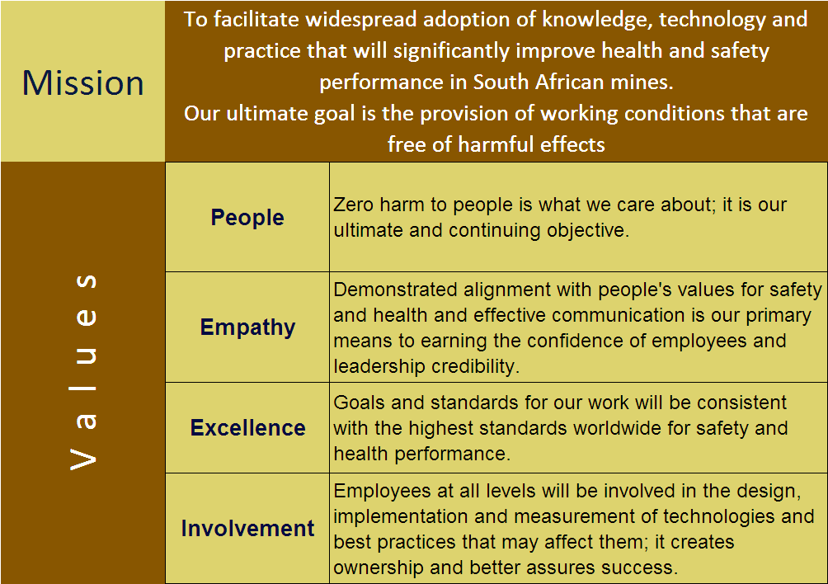
Mission and Values – MOSH
To facilitate the adoption of leading practice through a people oriented process to significantly improve occupational health and safety in the minerals industry
Our ultimate goal is the provision of working conditions that are free from harmful effects
Values
Leading the change to zero harm

Slide 4
Mission and Values – MOSH Dust
To facilitate the adoption of leading practices through a people oriented process to significantly improve occupational health and safety in the minerals industry with specific focus on THE ELIMINATION OF SILICOSIS AND DUST RELATED DISEASES
Values
Leading the change to zero harm

Slide 5
Progress update - key indicators from Team Scorecard
Covering identification, documenting, facilitating and impacts for the practices in question
KPA No | Key Performance Area | KPI No | KPI | Measure 1 (Definition) | Measure 2 (Definition) | Measure 1 | Measure 2 | Originally planned completion
A1 | Appropriate participants in selection of leading practice | T1 | Credible team membership | Yes | 18-07-12 | 100 | Ongoing on quarterly basis | 18-07-12 17-10-12 17-01-13 14-02-13
 |  | T2 | Ensure discipline input | Yes | 18-07-12 | 100 | 18-07-12 | 18-07-12
 |  | T3 | Ensure group input | Yes | 18-07-12 | 100 | 17-10-12 | 17-10-12
 |  | T4 | Approved participants list | Yes | Jul 2012 | 100 | Jul 2012 | Jul 2012
 |  | T5 | Peer Group assessment | Yes | May 2012 | 100 | May 2012 | May 2012
A2 | Appropriate plans for planning workshop | T6 | Competent Facilitator | Yes | 13-09-12 | 100 | 25-09-12 | 25-09-12
 |  | T7 | Planning agenda | Yes | 13-09-12 | 100 | 25-09-12 | 25-09-12
A3 | Detailed expert model of risk story | T9 | Stakeholder consultation | Yes | July 2012 and October 2012 | 100 | July 2012 and October 2012 | 17-10-12
 |  | T10 | Prepared questions for input | Yes | July 2012 and October 2012 | 100 | July 2012 and October 2012 | 17-10-12
Leading the change to zero harm

Slide 6
Progress update - key indicators cont.
KPA No | Key Performance Area | KPI No | KPI | Measure 1 (Definition) | Measure 2 (Definition) | Measure 1 | Measure 2 | Originally planned completion
 |  | T11 | Consultation draft expert model | Yes | July 2012 | 100 | July 2012 | 17-10-12
 |  | T12 | Detailed expert models | Yes | August 2012 | 100 | 17-10-12 | 17-10-12
 |  | T13 | Major risks and improvement possibilities | Yes | August 2012 | 100 | July 2012 | Aug 2012
 |  | T14 | Peer Group assessment | No | Oct 2012 | 100 | 17-10-12 | 17-10-12
Leading the change to zero harm

Slide 7
Progress update - key indicators cont.
KPA No | Key Performance Area | KPI No | KPI | Measure 1 (Definition) | Measure 2 (Definition) | Measure 1 | Measure 2 | Originally planned completion
A4 | Leading practice with greatest potential OHS impact | T15 | Review of R&D outcomes | Yes | 2008 | 100 | Ongoing on quarterly basis | 2008
 |  | T16 | Industry identified practices | Yes | Feb’12 (5) 2008 | 100 | Ongoing on quarterly basis | Feb’12
 |  | T17 | Exploratory visits to mines | Yes | May’12 | 100 | Ongoing on quarterly basis | May’12
 |  | T18 | Detailed Leading Practice List | Yes (T16 vs T18)? | 2008 and 2012 | 100 | Ongoing on quarterly basis | Up-dated quarterly
 |  | T19 | Credibility of selected Leading Practice | Yes | Jun’12 | 100 | ? | ?
 |  | T20 | Workshop quality | Cannot assess the quality
Leading the change to zero harm

Slide 8
SLP - Key Indicators
KPA No | Key Performance Area | KPI No | KPI | QAFS | Multi-stage Filtration Systems | Winch Covers | Water Blast | Telescopic Spray | Air Quality Management | Real-time monitoring
IDENTIFY
A 23 | SLP adoption | T112 | Identified potential SLP adoption mines | Yes | Yes | Yes | Yes | Yes | Yes | Yes
 |  | T113 | Full Adoption Team assessment of SLP | Yes | Yes | Yes | Yes | Yes | Yes | Yes
 |  | T114 | Contact manager of source mine to arrange access | Yes | Yes | Yes | Yes | Yes | Yes | Yes
 |  | T115 | Identify key contact person at source mine | Yes | Yes | Yes | Yes | Yes | Yes | Yes
DOCUMENT
 |  | T116 | Conduct investigations at source mine | 100% (100%) | 100% (100%) | 100% (100%) | 100% (100%) | 100% (100%) | 100% (0%) | 100% (50%)
 |  | T117 | Prepare documents for formal SLP assessment | 50% (0%) | 100% (100%) | 100% (100%) | 100% (100%) | 100% (100%) | 0% (0%) | 50% (0%)
 |  | T118 | Confirm accuracy of prepared documents with source mine | 0% (0%) | 100% (100%) | 100% (100%) | 100% (100%) | 100% (100%) | 0% (0%) | 0% (0%)
 |  | T119 | Final review of documents against SLP criteria by adoption team | 0% (0%) | 100% (100%) | 100% (100%) | 100% (100%) | 100% (100%) | 0% (0%) | 0% (0%)
 |  | T120 | Submit motivation of SLP to Head of Hub | 0% (0%) | 100% (100%) | 100% (100%) | 100% (0%) | 100% (0%) | 0% (0%) | 0% (0%)

Slide 9
SLP - Key Indicators
KPA No | Key Performance Area | KPI No | KPI | QAFS | Multi-stage Filtration Systems | Winch Covers | Water Blast | Telescopic Spray | Spray Configuration at Transfer Points | Real-time monitoring
DOCUMENT (cont.)
 |  | T121 | Convene SLP review panel | - | 100% (100%) | 100% (100%) | HoLH to advise | HoLH to advise | - | -
 |  | T122 | Formal review of SLP by review panel | - | 100% (100%) | 100% (100%) | - | - | - | -
 |  | T123 | Conduct any necessary follow-up investigations | - | Not required | 100% (100%) | - | - | - | -
 |  | T124 | Prepare customised SLP behaviour plans | - | 100% (100%) | 100% (100%) | - | - | - | -
 |  | T125 | Develop guidance notes for SLP adoption | - | 100% (100%) | 100% (100%) | - | - | - | -
 |  | T126 | Prepare SLP Adoption Brief | - | 100% (100%) | 100% (100%) | - | - | - | -
 |  | T127 | Critical review of SLP Adoption Brief | - | 100% (100%) | 100% (100%) | - | - | - | -
Leading the change to zero harm

Slide 10
SLP - Key Indicators
KPA No | Key Performance Area | KPI No | KPI | QAFS | Multi-stage Filtration Systems | Winch Covers | Water Blast | Telescopic Spray | Spray Configuration at Transfer Points | Real-time monitoring
FACILITATE
 |  | T128 | Update list of potential adoption mines | - | 100% (100%) | 100% (100%) | - | - | - | -
 |  | T129 | Identify key contact persons at potential adoption mines | - | 100% (100%) | 100% (100%) | - | - | - | -
 |  | T130 | Arrange SLP Briefing Workshop | - | 100% (100%) | 100% (100%) | - | - | - | -
 |  | T131 | Circulate SLP Adoption Brief to potential adoption mines | - | 100% (100%) | 100% (100%) | - | - | - | -
 |  | T132 | Conduct SLP Briefing Workshop | - | 100% (100%) | 100% (100%) | - | - | - | -
 |  | T133 | Establish SLP interest group if required | - | 100% (100%) | 100% (100%) | - | - | - | -
 |  | T134 | Initiate process of mines reporting on adoption | - | 100% (100%) | 100% (100%) | - | - | - | -
 |  | T135 | Provide SLP adoption brief for use at other meetings | - | 100% (100%) | 100% (100%) | - | - | - | -
 |  | T136 | Monthly follow-up communication with potential adoption mines | - | Scheduled meetings finalised |  | - | - | - | -
 |  | T137 | Arrange meetings / terminate SLP Interest Group as necessary | - | Scheduled meetings finalised |  | - | - | - | -
Next scheduled meeting: 13-05-14

Slide 11
Progress for the Month
No | Highlights (Achievements, Industry Interactions)
1 | Positive interaction at the Interest Group meeting on winch cover and multi-stage filtration system
Monthly MOSH meeting: 10-04-14
Kopanang mine EXCO meeting: 10-04-14
Task Force meeting: 11-04-14
SLP Interest Group meeting: 15-04-14
Kopanang mine meeting: 23-04-14
Aircure meeting (AirHead discussion): 25-04-14
Weekly Team meetings
Leading the change to zero harm

Slide 12
Progress for the Month
No | Lowlights (Issues, Risks, Concerns) | Response - Remedial Action | Due Date | Resp. Person
1 | Nil to report on for reporting period | n/a | n/a | n/a
Leading the change to zero harm

Slide 13
Key lessons learnt
No | Key lessons learnt
1 | Nil to report on for the reported period
Leading the change to zero harm

