Slide 1


DUST TEAM u p - d a t e
January 2015 to date
by
Gerrie Pienaar, Johan van Rensburg and Dr Audrey Banyini
18 February 2015
CHAMBER OF MINES OF SOUTH AFRICA
Putting South Africa First

Slide 2

Contents
Mission and values reminder
Progress update – key indicators
Highlights
Lowlights
Key lessons learnt
SLP progress
Important dates/events
Leading the change to zero harm

Slide 3
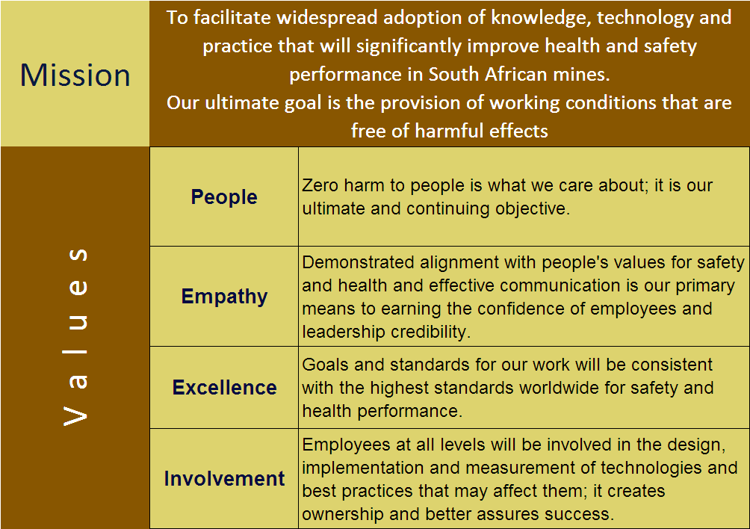
Mission and Values – MOSH
To facilitate the adoption of leading practice through a people oriented process to significantly improve occupational health and safety in the minerals industry
Our ultimate goal is the provision of working conditions that are free from harmful effects
Values
Leading the change to zero harm

Slide 4
Mission and Values – MOSH Dust
To facilitate the adoption of leading and/or simple leading practices through a people oriented process to significantly improve occupational health in the minerals industry with specific focus on THE ELIMINATION OF SILICOSIS AND DUST RELATED DISEASES
Values
Leading the change to zero harm

Slide 5
Leading Practice - key indicators
KPA No | Key Performance Area | KPI No | KPI | Continuous real-time monitoring of engineering dust controls
A1 | Appropriate persons to select leading practice | T4 | Approved participants list | 100% (100%)
A2 | Appropriate plans for planning workshop | T8 | HOH review and approval | 100% (100%)
A3 | Detailed expert model of risk story | T12 | Detailed expert models | 100% (100%)
 |  | T14 | Peer Group assessment | 0% (0%)
A4 | Leading practice with greatest OHS impact | T19 | Credibility of selected Leading Practice | 100% (100%)
A5 | Adoption mines and key people | T22 | Prioritised list of mines and key people | 100% (100%)
A6 | Direct enquiry protocol | T27 | Direct enquiry protocol | 100% (0%)
A7 | Effective direct enquiry process | T30 | Interview process | Moab Khutsong: Completed Beatrix: Completed Phakisa: Completed Mamatwan: 16-18/02/15 Impala Platinum: 24-02-15
A8 | Detailed mental models report | T33 | Mental models report | -
 |  | T34 | Identification of implications | -
Leading the change to zero harm

Slide 6
SLP - Key Indicators
KPA No | KPA | KPI No | KPI | Multi-stage Filtration Systems | Winch Covers | Water Blast | Telescopic Spray | Stop-and-fix: managing worker dust exposure with real-time monitoring at a Primary Tip - Collieries
IDENTIFY
A 23 | SLP adoption | T112 | Identified potential SLP adoption mines | Yes | Yes | Yes | Yes | Yes
 |  | T113 | Full Adoption Team assessment of SLP | Yes | Yes | Yes | Yes | Yes
 |  | T114 | Contact manager of source mine to arrange access | Yes | Yes | Yes | Yes | Yes
 |  | T115 | Identify key contact person at source mine | Yes | Yes | Yes | Yes | Yes
DOCUMENT
 |  | T116 | Conduct investigations at source mine | 100% (100%) | 100% (100%) | 100% (100%) | 100% (100%) | 100% (100%)
 |  | T117 | Prepare documents for formal SLP assessment | 100% (100%) | 100% (100%) | 100% (100%) | 100% (100%) | 100% (100%)
 |  | T118 | Confirm accuracy of prepared documents with source mine | 100% (100%) | 100% (100%) | 100% (100%) | 100% (100%) | 100% (100%)
 |  | T119 | Final review of documents against SLP criteria by adoption team | 100% (100%) | 100% (100%) | 100% (100%) | 100% (100%) | 100% (100%)
 |  | T120 | Submit motivation of SLP to Head of Hub | 100% (100%) | 100% (100%) | 100% (100%) | 100% (100%) | 100% (100%)
Name change pending

Slide 7
SLP - Key Indicators
KPA No | KPA | KPI No | KPI | Multi-stage Filtration Systems | Winch Covers | Water Blast | Telescopic Spray | Stop-and-fix: managing worker dust exposure with real-time monitoring at a Primary Tip - Collieries
DOCUMENT (cont.)
 |  | T121 | Convene SLP review panel | 100% (100%) | 100% (100%) | HoLH to advise | HoLH to advise | HoLH to advise
 |  | T122 | Formal review of SLP by review panel | 100% (100%) | 100% (100%) | - | - | Post 17 Mar 2015
 |  | T123 | Conduct any necessary follow-up investigations | Not required | 100% (100%) | - | - | -
 |  | T124 | Prepare customised SLP behaviour plans | 100% (100%) | 100% (100%) | - | - | -
 |  | T125 | Develop guidance notes for SLP adoption | 100% (100%) | 100% (100%) | - | - | -
 |  | T126 | Prepare SLP Adoption Brief | 100% (100%) | 100% (100%) | - | - | -
 |  | T127 | Critical review of SLP Adoption Brief | 100% (100%) | 100% (100%) | - | - | -
Planned for 1st QTR 2015??
Leading the change to zero harm

Slide 8
SLP - Key Indicators
KPA No | KPA | KPI No | KPI | Multi-stage Filtration Systems | Winch Covers | Water Blast | Telescopic Spray | Stop-and-fix: managing worker dust exposure with real-time monitoring at a Primary Tip - Collieries
FACILITATE
 |  | T128 | Update list of potential adoption mines | 100% (100%) | 100% (100%) | - | - | -
 |  | T129 | Identify key contact persons at potential adoption mines | 100% (100%) | 100% (100%) | - | - | -
 |  | T130 | Arrange SLP Briefing Workshop | 100% (100%) | 100% (100%) | - | - | -
 |  | T131 | Circulate SLP Adoption Brief to potential adoption mines | 100% (100%) | 100% (100%) | - | - | -
 |  | T132 | Conduct SLP Briefing Workshop | 100% (100%) | 100% (100%) | - | - | -
 |  | T133 | Establish SLP interest group if required | 100% (100%) | 100% (100%) | - | - | -
 |  | T134 | Initiate process of mines reporting on adoption | 100% (100%) | 100% (100%) | - | - | -
 |  | T135 | Provide SLP adoption brief for use at other meetings | 100% (100%) | 100% (100%) | - | - | -
 |  | T136 | Monthly follow-up communication with potential adoption mines | Scheduled meetings finalised |  | - | - | -
 |  | T137 | Arrange meetings / terminate SLP Interest Group as necessary | Scheduled meetings finalised |  | - | - | -
Next scheduled meeting: 10 March 2015

Slide 9
Progress for the Month
No | Highlights (Achievements, Industry Interactions)
1 | None to report on
Direct inquiry Phakisa: 20-01-15
Direct inquiry Beatrix: 21-01-15
2nd Peer Review Panel visit to Kopanang: 28-01-15
Monthly MOSH meeting: 22-01-15
Dust Sponsor meeting: 27-01-15
Interest Group meeting: 10-02-15
MOSHIAT-D meeting: 12-02-15
Direct inquiry Mamatwan: 16-18-02-15
Leading the change to zero harm

Slide 10
Progress for the Month
No | Lowlights (Issues, Risks, Concerns) | Response - Remedial Action | Due Date | Resp. Person
1 | Poor attendance of Interest Group meeting held on 10-02-15 | Discussed at MOSHIAT-D for assistance | 12-02-15 | GP and MOSHIAT-D members
2 | MOSHIAT-D membership inappropriate | Send out request for nominees and alternates to serve on the MOSHIAT-D Terms of Reference (ToR) for MOSHIAT-D will be circulated again for info to the relevant stakeholders | End Feb’15 | GP/AB
Leading the change to zero harm

Slide 11
Key lessons learnt
No | Key lessons learnt
1 | Importance of on-mine MOSH agent
Leading the change to zero harm

Slide 12
SLP Progress Report
Winch Covers
56.7
Previous month
Leading the change to zero harm

Slide 13
SLP Adoption Tracker
Winch Covers
Leading the change to zero harm

Slide 14
SLP Progress Report
Multi-stage Filtration System
86.6
Previous month
Leading the change to zero harm

Slide 15
SLP Adoption Tracker
Multi-stage Filtration
System
Leading the change to zero harm

Slide 16
Important dates/events
11-03-15
2nd Dust Indaba
17-03-15
Terence u/g at Kopanang
20-04-15
LP Launch (Continuous Real-time Monitoring of Airborne Pollutant Engineering Controls)
Who:
Industry
Where:
Glenburn Lodge
Who:
AngloGold Ashanti Corporate
MOSH Learning Hub
Kopanang Team
Where:
Kopanang Mine
Who:
Industry
Where:
Glenburn Lodge
Other Events:
Direct inquiry process at Mamatwan : 16-02-15 to 18-02-15
Direct inquiry process at Implats : 24-02-15
MOSHIAT-D (Coal) at Glencore : 27-02-15
This is to conclude the Real-time monitoring Leading Practice process and to finalise the LPAG
Leading the change to zero harm

Slide 17


L E A R N I N G H U B
DUST TEAM
011 498 7100
Or visit our website: www.mosh.co.za
Dr Audrey Banyini
ABanyini@chamberofmines.org.za
Gerrie Pienaar
gerriepienaar69@gmail.com
Johan van Rensburg
johan.c.vanrensburg@angloamerican.com
L E A R N I N G H U B

