Slide 1
MOSH Falls of Ground Team
Leading Practice
Adoption Team
Activity Report
21 November 2013

Slide 2

Contents
Mission and Values reminder
Progress update – key indicators
Highlights
Challenges
Key lessons learnt

Slide 3
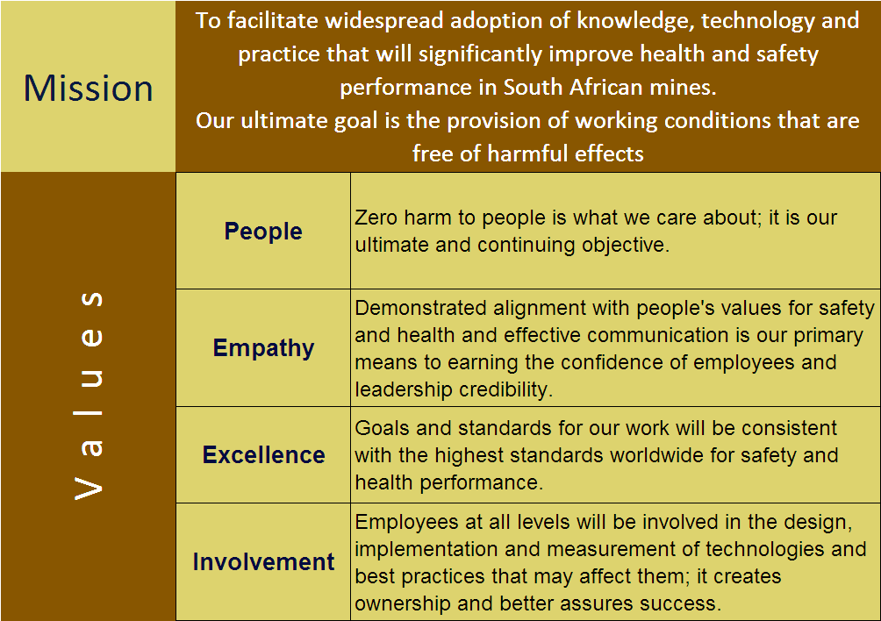
Mission and Values - MOSH
To facilitate the adoption of leading practice through a people oriented process to significantly improve occupational health and safety in the minerals industry
Our ultimate goal is the provision of working conditions that are free from harmful effects
Values
Leading the change to zero harm

Slide 4
FOG Adoption Team Planner
Revisiting adoption at mines and tightening the loose ends, on going process.
Eastern Limb COPA was held on the 16/Oct hosted by Dwaars river mine. +/- 30 attendees (14 mines attended)
Progressing with TARP Adoption, Several mines are part of the source mine (Xstrata mines), Anglo Platinum mines have advanced ABSP implementation
13 Mines participating
Good progress by some mines
32% Complete
44 Mines are participating in NwB. 88% completed with adoption
45 Mines participating in TARP - 56% completed with adoption – Interpretation of direct inquiry results
Next COPA meeting scheduled for 29 November 2013 at Randfontein Golf Club.
Assisting individual mines in 4 regions of Central COPA through additional COPA meetings
Harmony is working as a group on the adoption of TARP
J 12 | J 12 | A 12 | S 12 | O 12 | N 12 | D 12 | J 13 | F 13 | M 13 | A 13 | M 13 | J 13 | J 13 | A 13 | S 13 | O 13 | N 13 | D 13
EE&MS
Hard Rock COPA (N&B’s, TARP)
N Cape COPA is progressing slowly. Most mines are still in the early stages of EE&MS adoption process
Last COPA was on the 3rd October 2013 at Finsch
Next COPA 4 December 2013 at BRMO
Eastern Limb COPA (EE&MS, TARP)
NC COPA (EE&MS, TARP)
A meeting was held with senior stakeholders in coal following the workshops and Minesafe 2013 to consider a LP with buffer blasting.
Those present are enthusiastic about pursuing the idea of FoG LPs through the MOSH approach. They want to set up regular meetings in 2014.
COAL COPA (Coal Specific Practices)
2014 Planning Workshop – 14 November 2013 at Glenburn Lodge
About 50 delegates, E upper and above attended. DMR & NUM apologised
A number of potential new LPs identified. Further work is needed in 2014 to assess these.
Plan
Prevention of All Uncontrolled Falls of Ground

Slide 5
Progress for the Month of October/November 2013
No` | Highlights (Achievements, Industry Interactions)
1 | Tripartite forums visited and positively participated. Duncan went to Vaal Reefs, Andre went to NC and Limpopo?
2 | A further workshop was held with the coal industry and a new potential LP for open cast strata stability was considered, to add to the three already LPs identified.
3 | The Netting with Bolting and TARP COPA on 18 October was attended by 90 people. There were a number of 3.1 and 4.1 appointees present from Harmony and AGA.
4 | Established additional support with COPA members . Visiting them in their respective areas. Harmony Group had their second meeting as a group to consider progress with TARP and Douw was invited to speak to them.
5 | Special additional help was given to Kusasalethu and Dwarsrivier mines to help their adoption process.
6 | The industry workshop was held on the 14 November and was a useful day to gauge the industry support for a new leading practice and to identify any potential new leading practices. A number of potential LPs were identified.
Leading the change to zero harm

Slide 6
Progress for the Month of October/November 2013
No | Challenge (Issues, Risks, Concerns) | Response - Remedial Action | Due Date | Resp. Person
1 | Getting the COAL sector on track for MOSH adoption | The current identified potential LPs will be investigated further and a workshop called to share results | February 2014 | Team
2 | Helping mines to complete PoEs before reporting | Discussions at COPAs, at Harmony’s special meeting and on special requests from individual mines | March 2014 | Team
3 | Follow-up to industry workshop to identify new LPs | Team to meet and complete the background work before further discussions with the FoG industry team in January 2014 | January 2014 | Team
Leading the change to zero harm

Slide 7
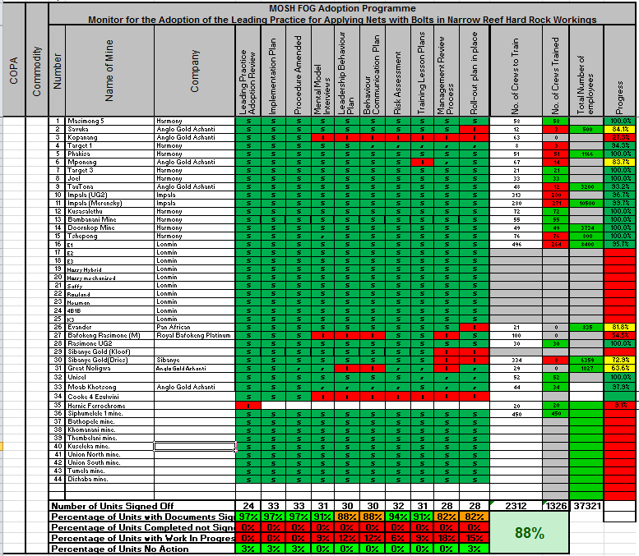

Slide 8
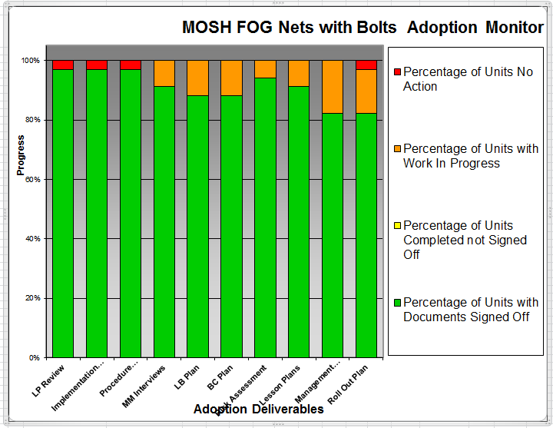

Slide 9
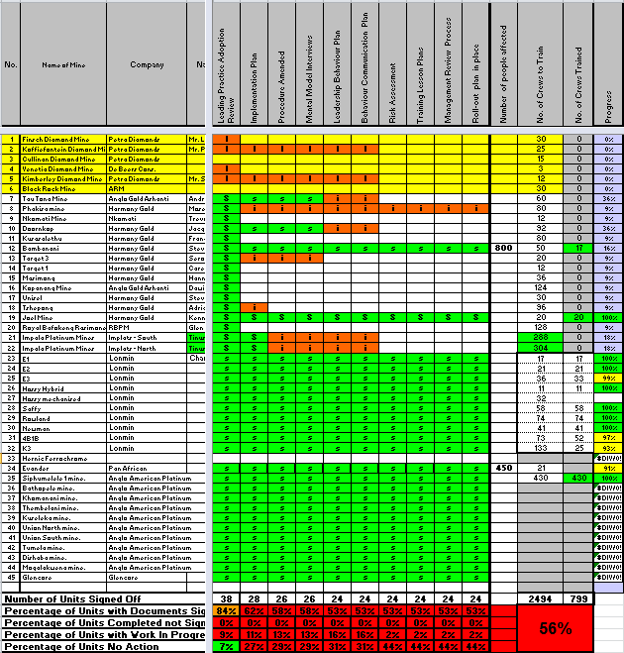

Slide 10
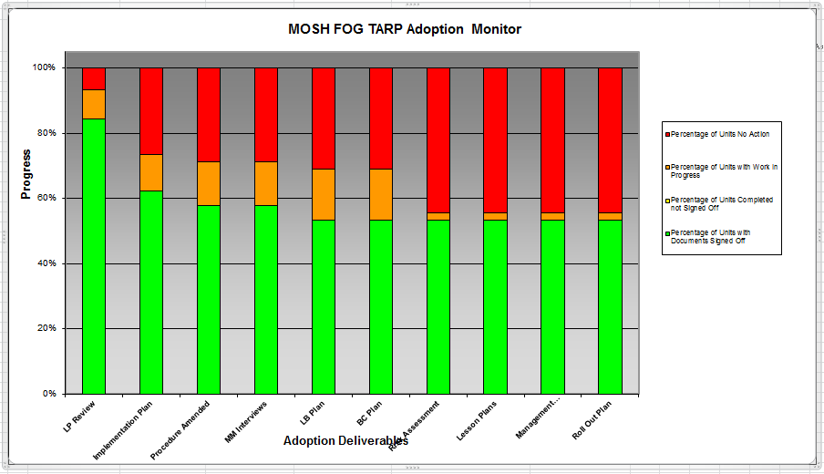

Slide 11
*32 participants

Slide 12
Survey Results
32 people completed the survey
5 questions deserve further comment
  Q3: Clear understanding of future – 8 people were neutral, 4 people disagreed and 2 people strongly disagreed.
    It was obviously not made clear to participants how the process would go forward. Follow-up documents from the workshop will address this.
  Q4: Money well spent – 9 people were neutral and 3 people disagreed.
    This is too many people who have doubts about the efficacy of MOSH. Further efforts needed to share successes.
  Q6: Making a difference to safety – 6 people were neutral and 1 disagreed
    This is too many people who are not convinced of the safety contribution of MOSH. Further efforts needed to connect MOSH initiatives to improvements in safety, if possible.
  Q7: Room for improvement – 26 people strongly agreed or agreed that improvements could be made.
    This is a high number of people who are saying adoption can improve and reason to hope for more input and commitment in the future, if we work together with industry. However, the question has to be asked why there is still so much room for improvement
  Q8: Applied well and correctly – 11 people were neutral and 4 disagreed
    Too many people are admitting that the adoption is not applied well which fits in with question 7. Again, an opportunity for working with industry to improve the situation

