Slide 1


DUST TEAM u p - d a t e
September 2013 to date
by
Gerrie Pienaar, Johan Janse van Rensburg and Dr Audrey Banyini
17 October 2013
CHAMBER OF MINES OF SOUTH AFRICA
Putting South Africa First

Slide 2

Contents
Mission and values reminder
Progress update – key indicators
Highlights
Lowlights
Key lessons learnt
Industry Team Members
Leading the change to zero harm

Slide 3
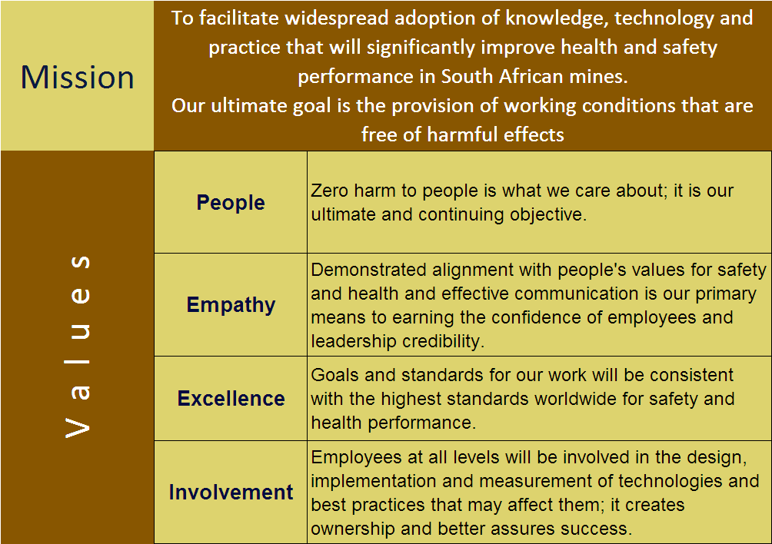
Mission and Values – MOSH
To facilitate the adoption of leading practice through a people oriented process to significantly improve occupational health and safety in the minerals industry
Our ultimate goal is the provision of working conditions that are free from harmful effects
Values
Leading the change to zero harm

Slide 4
Mission and Values – MOSH Dust
To facilitate the adoption of leading practices through a people oriented process to significantly improve occupational health and safety in the minerals industry with specific focus on THE ELIMINATION OF SILICOSIS AND DUST RELATED DISEASES
Values
Leading the change to zero harm

Slide 5
Progress update - key indicators from Team Scorecard
Covering identification, documenting, facilitating and impacts for the practices in question
KPA No | Key Performance Area | KPI No | KPI | Measure 1 (Definition) | Measure 2 (Definition) | Measure 1 | Measure 2 | Originally planned completion
A1 | Appropriate participants in selection of leading practice | T1 | Credible team membership | Yes | 18-07-12 | 100 | Ongoing on quarterly basis | 18-07-12 17-10-12 17-01-13 14-02-13
 |  | T2 | Ensure discipline input | Yes | 18-07-12 | 100 | 18-07-12 | 18-07-12
 |  | T3 | Ensure group input | Yes | 18-07-12 | 100 | 17-10-12 | 17-10-12
 |  | T4 | Approved participants list | Yes | Jul 2012 | 100 | Jul 2012 | Jul 2012
 |  | T5 | Peer Group assessment | Yes | May 2012 | 100 | May 2012 | May 2012
A2 | Appropriate plans for planning workshop | T6 | Competent Facilitator | Yes | 13-09-12 | 100 | 25-09-12 | 25-09-12
 |  | T7 | Planning agenda | Yes | 13-09-12 | 100 | 25-09-12 | 25-09-12
A3 | Detailed expert model of risk story | T9 | Stakeholder consultation | Yes | July 2012 and October 2012 | 100 | July 2012 and October 2012 | 17-10-12
 |  | T10 | Prepared questions for input | Yes | July 2012 and October 2012 | 100 | July 2012 and October 2012 | 17-10-12
Leading the change to zero harm

Slide 6
Progress update - key indicators cont.
KPA No | Key Performance Area | KPI No | KPI | Measure 1 (Definition) | Measure 2 (Definition) | Measure 1 | Measure 2 | Originally planned completion
 |  | T11 | Consultation draft expert model | Yes | July 2012 | 100 | July 2012 | 17-10-12
 |  | T12 | Detailed expert models | Yes | August 2012 | 100 | 17-10-12 | 17-10-12
 |  | T13 | Major risks and improvement possibilities | Yes | August 2012 | 100 | July 2012 | Aug 2012
 |  | T14 | Peer Group assessment | No | Oct 2012 | 100 | 17-10-12 | 17-10-12
Leading the change to zero harm

Slide 7
Progress update - key indicators cont.
KPA No | Key Performance Area | KPI No | KPI | Measure 1 (Definition) | Measure 2 (Definition) | Measure 1 | Measure 2 | Originally planned completion
A4 | Leading practice with greatest potential OHS impact | T15 | Review of R&D outcomes | Yes | 2008 | 100 | Ongoing on quarterly basis | 2008
 |  | T16 | Industry identified practices | Yes | Feb’12 (5) 2008 | 100 | Ongoing on quarterly basis | Feb’12
 |  | T17 | Exploratory visits to mines | Yes | May’12 | 100 | Ongoing on quarterly basis | May’12
 |  | T18 | Detailed Leading Practice List | Yes (T16 vs T18)? | 2008 and 2012 | 100 | Ongoing on quarterly basis | Up-dated quarterly
 |  | T19 | Credibility of selected Leading Practice | Yes | Jun’12 | 100 | ? | ?
 |  | T20 | Workshop quality | Cannot assess the quality
Leading the change to zero harm

Slide 8
SLP - Key Indicators
KPA No | Key Performance Area | KPI No | KPI | QAFS | Multi-stage Filtration Systems | Winch Covers | Water Suppression Systems | Spray Configuration at Transfer Points
IDENTIFY
A23 | SLP adoption | T112 | Identified potential SLP adoption mines | Yes | Yes | Yes | Yes | Yes
 |  | T113 | Full Adoption Team assessment of SLP | Yes | Yes | Yes | Yes | Yes
 |  | T114 | Contact manager of source mine to arrange access | Yes | Yes | Yes | Yes | Yes
 |  | T115 | Identify key contact person at source mine | Yes | Yes | Yes | Yes | Yes
DOCUMENT
 |  | T116 | Conduct investigations at source mine | 100% (100%) | 100% (100%) | 100% (100%) | 100% (20%) | 100% (0%)
 |  | T117 | Prepare documents for formal SLP assessment | 0% (0%) | 100% (100%) | 100% (100%) | 100% (0%) | 100% (50%)
 |  | T118 | Confirm accuracy of prepared documents with source mine | 0% (0%) | 100% (100%) | 100% (100%) | 100% (0%) | 50% (0%)
 |  | T119 | Final review of documents against SLP criteria by adoption team | 0% (0%) | 100% (100%) | 100% (100%) | 17-10-13 (0%) | 25-10-13 (0%)
 |  | T120 | Submit motivation of SLP to Head of Hub | 0% (0%) | 100% (100%) | 100% (100%) | 24-10-13 (0%) | 31-10-13 (0%)
Leading the change to zero harm

Slide 9
SLP - Key Indicators
KPA No | Key Performance Area | KPI No | KPI | QAFS | Multi-stage Filtration Systems | Winch Covers | Water Suppression Systems | Spray Configuration at Transfer Points
DOCUMENT (cont.)
 |  | T121 | Convene SLP review panel | - | 100% (100%) | 100% (100%) | - | -
 |  | T122 | Formal review of SLP by review panel | - | 100% (100%) | 100% (100%) | - | -
 |  | T123 | Conduct any necessary follow-up investigations | - | Not required | 100% (100%) | - | -
 |  | T124 | Prepare customised SLP behaviour plans | - | 100% (100%) | 100% (100%) | - | -
 |  | T125 | Develop guidance notes for SLP adoption | - | 100% (100%) | 100% (100%) | - | -
 |  | T126 | Prepare SLP Adoption Brief | - | 100% (100%) | 100% (100%) | - | -
 |  | T127 | Critical review of SLP Adoption Brief | - | 100% (100%) | 100% (100%) | - | -
Leading the change to zero harm

Slide 10
SLP - Key Indicators
KPA No | Key Performance Area | KPI No | KPI | QAFS | Multi-stage Filtration Systems | Winch Covers | Water Suppression Systems | Spray Configuration at Transfer Points
FACILITATE
 |  | T128 | Update list of potential adoption mines | - | 100% (100%) | 100% (100%) | - | -
 |  | T129 | Identify key contact persons at potential adoption mines | - | 100% (100%) | 100% (100%) | - | -
 |  | T130 | Arrange SLP Briefing Workshop | - | 100% (100%) | 100% (100%) | - | -
 |  | T131 | Circulate SLP Adoption Brief to potential adoption mines | - | 100% (100%) | 100% (100%) | - | -
 |  | T132 | Conduct SLP Briefing Workshop | - | 100% (100%) | 100% (100%) | - | -
 | Awaiting feedback from some mining groups | T133 | Establish SLP interest group if required | - | - | - | - | -
 |  | T134 | Initiate process of mines reporting on adoption | - | - | - | - | -
 |  | T135 | Provide SLP adoption brief for use at other meetings | - | - | - | - | -
 |  | T136 | Monthly follow-up communication with potential adoption mines | - | - | - | - | -
 |  | T137 | Arrange meetings / terminate SLP Interest Group as necessary | - | - | - | - | -
Leading the change to zero harm

Slide 11
Progress for the Month
No | Highlights (Achievements, Industry Interactions)
1 | Progress made in terms of SLP’s feedback – only one group outstanding (AngloGold Ashanti - have commitment)
2 | Supporting communication material for Multi-stage Filtration System finalised and ready to present at MineSafe 2013
Advisory Committee Meeting: 03-09-13
Meeting with JINCOM and HOLH: 04-09-13
Leeuwpan Colliery: 04-09-13
Meeting with COM Safety Dept.: 09-09-13 (discussion on guidance for CTF feedback)
Kopanang meeting: 11-09-13
Monthly MOSH meeting: 19-09-13
AGA meeting: 20-09-13
Weekly Team meetings
Meeting with Dust Sponsor: 07-10-13
Leading the change to zero harm

Slide 12
Progress for the Month
No | Lowlights (Issues, Risks, Concerns) | Response - Remedial Action | Due Date | Resp. Person
1 | Industry manage towards legal compliance rather than ALARA | Create an understanding of the accumulative effect of dust exposure | 17-10-13 25-10-13 | GP/AB/JJvR/MOSHIAT-D and GEE’s
Leading the change to zero harm

Slide 13
Key lessons learnt
No | Key lessons learnt
1 | There were no lessons learnt for the reported period
Leading the change to zero harm

Slide 14
MOSHIAT-D Members
Foskor
Adolf Dreyer
adolfd@foskor.co.za
Glencore
Richard Vermaak
Richard.Vermaak@glencore.co.za
Gold1
Mervin van Rooyen
Mervin.VanRooyen@Gold1.co.za
ARM
Nerine Botes
Nerine.Botes@arm.co.za
Petra Diamonds
Jacques Olivier
jacqueso@petradiamonds.com
RBM
Johan Jacobs
johan.jacobs@rbm.co.za
Taulekoa
Peet van der Westhuizen
peetv@taulekoa.co.za
bhpbilliton
Navarre Kruger
Navarre.Kruger@bhpbilliton.com
Taulekoa
Peet van der Westhuizen
peetv@taulekoa.co.za
Gold Fields
Mike de Koker
Mike.deKoker@goldfields.co.za
Royal Bafokeng Platinum
Roger Barrat
rbarratt@Bafokengplatinum.co.za
Sibanye Gold
Dirk van Greuning
Dirk.vanGreuning@sibanyegold.co.za
Xstrata
Richard Mondela
rmondela@xstrata.co.za
Murry&Roberts
Yolanda Grobbelaar
Yolanda.grobbelaar@murrob.com
De Beers Group
Steve Blake
steve.blake@debeersgroup.com
Leading the change to zero harm

Slide 15
MOSHIAT-D Members
AngloGold Ashanti
Andre Marais
AMarais@AngloGoldAshanti.com
Miranda Melk
MMelk@AngloGoldAshanti.com
Glenda Peens
GPeens@AngloGoldAshanti.com
Morne Beukes
MBeukes@AngloGoldAshanti.com
Amplats
Bruce Doyle
bruce.doyle@angloamerican.com
JJ van Staden
johannes.vanstaden@angloamerican.com
Ronald Mothlamme
ronald.motlhamme@angloamerican.com
LONMIN
Leon Kinnear
Leon.Kinnear@lonmin.com
Braam Minnaar
braam.minnaar@lonmin.com
Implats
Anton Botha
Anton.Botha@implats.co.za
James van Rensburg
james.vanrensburg@implats.co.za
Anglo American
Poupienah Makgatho
poupienah.makgatho@angloamerican.com
Harry Barnard
harry.barnard@angloamerican.com
Pieter van Coller
pieter.vancoller@angloamerican.com
Harmony
Alwyn Jordaan
Alwyn.Jordaan@Harmony.co.za
Mike van Deventer
Mike.vDeventer@Harmony.co.za
Total groups: 21
Total members: 31
Some alternate members not listed
Leading the change to zero harm

Slide 16
MOSHIAT-D Coal Members
bhpbilliton
Hansie van der Merwe
Hansie.vanderMerwe@bhpbilliton.com
Mpho Hlaka
mpho.hlaka@bhpbilliton.com
Hulile Ndlovu
hulile.ndlovu@bhpbilliton.com
Tokkie Roets
tokkie.roets@bhpbilliton.com
Willie Zuki
Zuki.Willie@bhpbilliton.com
Jama Mhlophe
Jama.Mhlophe@bhpbilliton.com
TOTAL Coal
Andre Krog
Andre.KROG@coal.total.co.za
Arnold Theron
Arnold.THERON@coal.total.co.za
Kangra Coal
Burt van Rensburg
burt@kangracoal.co.za
Forbes Coal
Peter Nkosi
pnkosi@forbescoal.co.za
exxaro
Stoffel Allers
Stoffel.Allers@exxaro.com
Meshack Dikana
Meshack.Dikana@exxaro.com
Avengmining
Pieter Ferriera
pieter.ferreira@avengmining.com
Anglo American
Andrew Thomson
andrew.thomson@angloamerican.com
Julize van Niekerk
julize.vanniekerk@angloamerican.com
Sello Khopa
sello.khopa@angloamerican.com
XSTRATA Coal
Errol Harvey
eharvey@xstratacoal.co.za
Total groups: 8
Total members: 17
Leading the change to zero harm

