Slide 1
Noise Adoption Team
17th October 2013

Slide 2

Contents
Key activities/highlights of the month
Lowlights
Key lessons learnt
Future activities

Slide 3
Key Team activities for the Month (Sep/Oct 2013)
No | Highlights (Achievements, Industry Interactions)
1. | HPD_TAS Adoption Finalizing Sasol (Coal fraternity) Capturing interviews (Various sites/shafts) Pilot shaft identified Twistdraai Colliery (Sigma) Impala Adoption Interview training (30 Oct 2013) Lonmin Adoption pending BECSA Pending ARM Modikwa – Busy Noise Interviews (Independent LB&BC) TRP & Nkomati – Implementing customized LB&BC plans Glencore Western & Eastern Limb Implementing customized LB&BC plans ( Western Limb) Capturing interview results (Mosh)

Slide 4
Key Team activities for the Month (Sep/Oct 2013)
No | Highlights (Achievements, Industry Interactions)
2. | Industry Team Meeting – 02nd October 2013 Customized HPD Management System Pursue as potential LP Refinements Lashing Unit Pursue as a SLP Approved Inspection Authority (AIA) OAE Verification More R&D required

Slide 5
Key Team activities for the Month (Sep/Oct 2013)
No | Highlights (Achievements, Industry Interactions)
3. | Noise Industry team meeting 02 October 2013 Well attended , and a multi disciplinary audience Commendations received from COM Health Department/ GEE’s/Attendees “Buy and Maintain Quiet Initiative” Draft (TOR’s) being circulated to Mosh Task Force (Approval) NW Tri-partite – Well received (On the correct path) CM&EE Assisting Industry to standardize on NRR derating parameters
No | Lowlights
1. | Slow adoption from some coal mines

Slide 6
Key lessons learnt
No | Key Lessons learnt
1. | Lessons learned (HPD Adoption Presentation)
Important activities
No | Activities
1. | 19 Sep 2013 – Lonmin HPD_TAS Verification - NRR Derating Applicability 20 Sep 2013 – MVS Milestone workshop 25 Sep 2013 – Tri partite meeting Mototolo 26 Sep 2013 – Sponsor meeting 02 Oct 2013 – Industry Team meeting 03 Oct 2013 – North West Tri-partite meeting 08 Oct 2013 – The Art of Hearing Conservation Conference 10 Oct 2013 - Noise team weekly meeting 15 Oct 2013 – Exxaro Matla 3 Noise team Management interaction 16 Oct 2013 – Noise team weekly meeting 17 Oct 2013 – Mosh Learning Hub Monthly meeting 18 Oct 2013 – Task Force meeting Future – Sibanye and Gold Fields visits

Slide 7
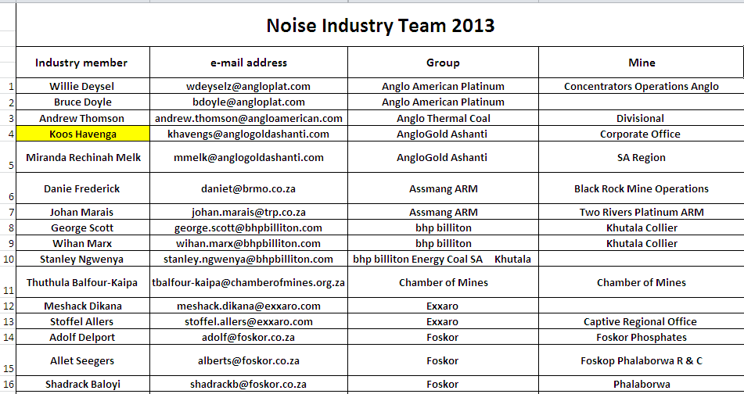
Industry Team Members

Slide 8
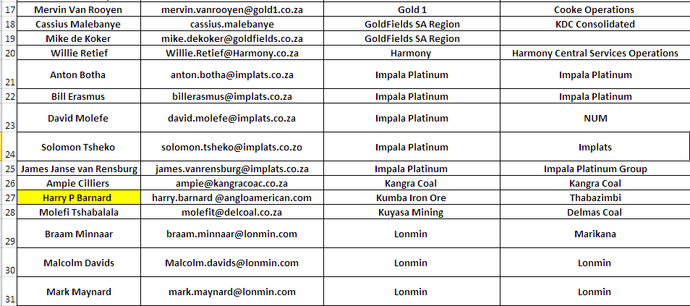
Industry Team Members

Slide 9
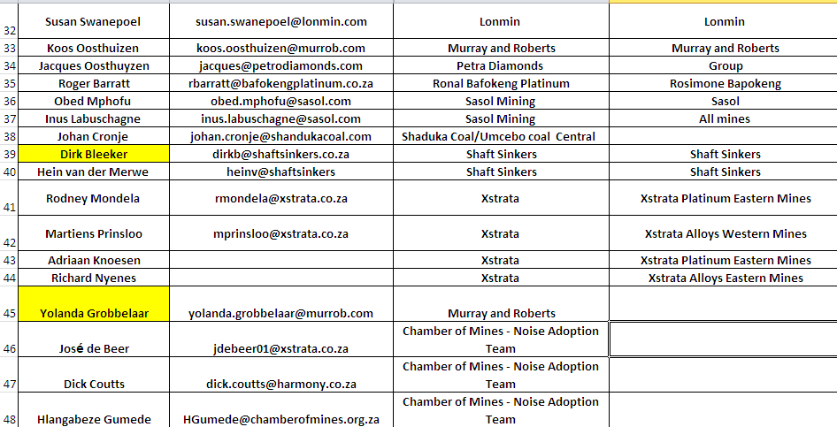
Industry Team Members

