Slide 1
CO Gas exposure and oel interpretations
JJ van Staden Occupational Hygiene Manager – Mining
19 May 2012
CONFIDENTIAL

Slide 2
Contents
Gas detection
Gas interpration
Reports
  Current
  The way forward
OEL Significance
  OEL s
  Blasting Fumes
CO Overexposure/Gassing
  BEI
  Exhaled air as screening method
CO / NOx

Slide 3
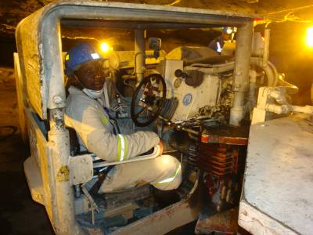
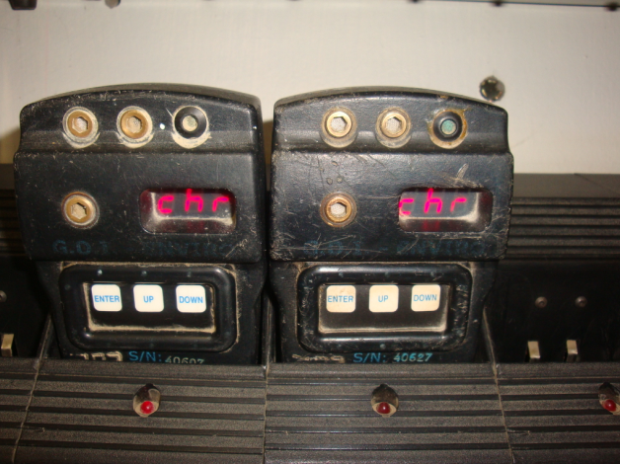
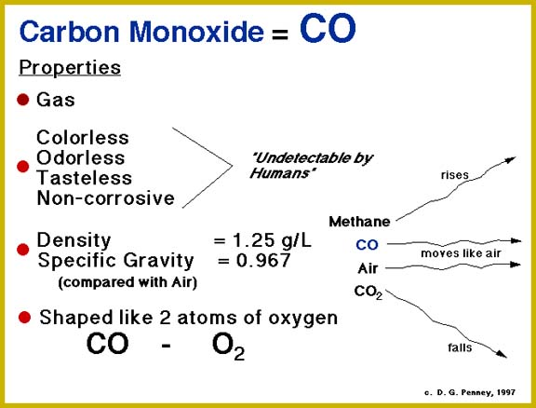
What is Carbon Monoxide
0.025 ppm - natural background atmosphere level
0.5 to 5 ppm - average background level in homes
5 to 15 ppm - stoves in homes
100-200 ppm - Mexico City central area from autos etc.
5,000 ppm - chimney of a home wood fire
7,000 ppm - undiluted warm car exhaust
30,000 ppm - undiluted cigarette smoke
Flammable limits in air - 12-75 vol. %

Slide 4
History of CO
"Coal fumes lead to heavy head and death" - First mention of the lethal effects of coal fumes --- Aristotle, Greece, 3rd century B.C. Inhabitants of Nuceria killed by CO suffocation in the bath --- Hannibal, Carthage, 247-183 B.C.
Coal fumes were used for suicide and execution --- Cicero, Rome, 106-43 B.C.; suicide of Roman author Seneca, 65 A.D.
A combustible gas that burned with a bright blue flame described --- Joseph Priestley, England, 1772
First clinical description of coal gas poisoning --- Harmant, France, 1775
Shown that CO produces hypoxia by reversible combination with hemoglobin --- Claude Bernard, France, 1857
Polar explorer Richard Byrd nearly loses life as result of chronic CO poisoning --- early 20th century
611 CO-related deaths occur in New York City from use of illuminating gas --- 1927
Treatment of CO poisoning with Hyperbaric Oxygen (HBO) in experimental animals --- End & Long, U.S., 1942
International tennis star Vitas Gerulaitus loses life in CO accident involving a pool heater, September, 1994

Slide 5
Is CO Managed on mines

Slide 6
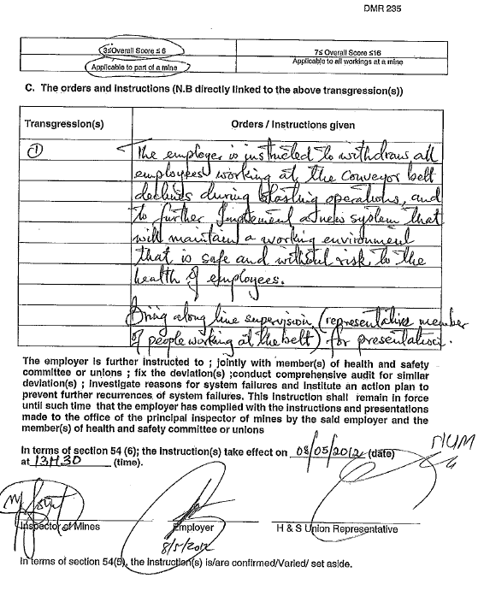
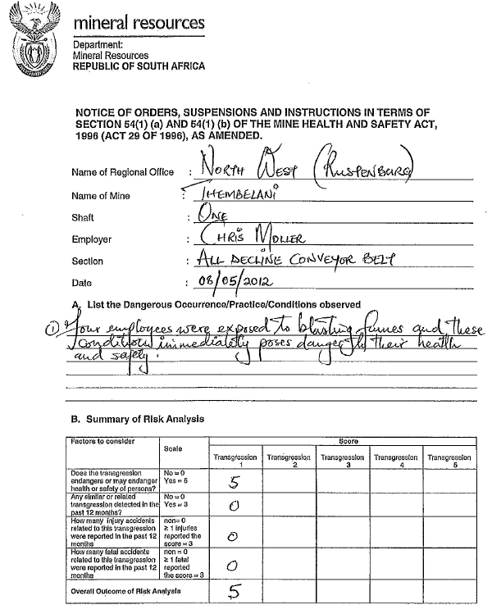

Slide 7
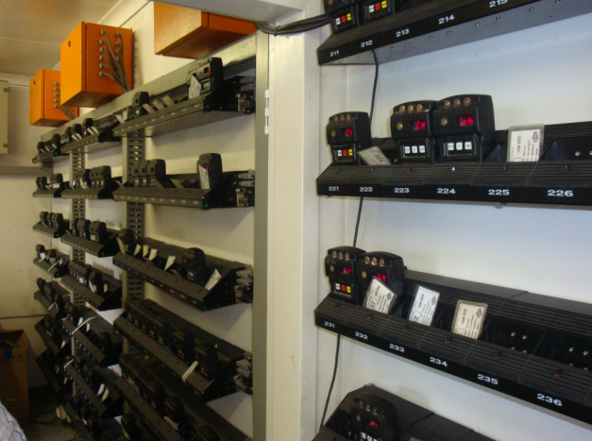
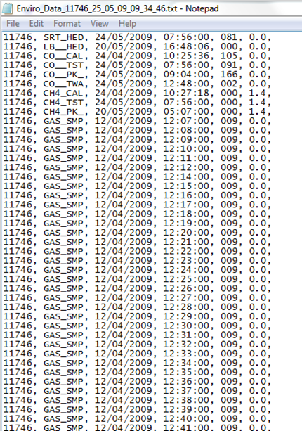
Present Situation
Workflow
    GDI Unit get tested at the beginning of the shift and allocated to a team leader
    At the end of the shift the GDI unit get placed into the docking station
    Data is downloaded onto the Data Acquisition unit (DAU)
    Limited static reports can be generated using the LMS software. This reports is only available on the PC with the LMS software installed at the specific operation
Limitations
    Data sharing dependant on Lampsman
      Difficult to share data with stakeholders
    No network access
    Limited reports
    No backups of data
    Data takes approx. 4 hours to download

Slide 8
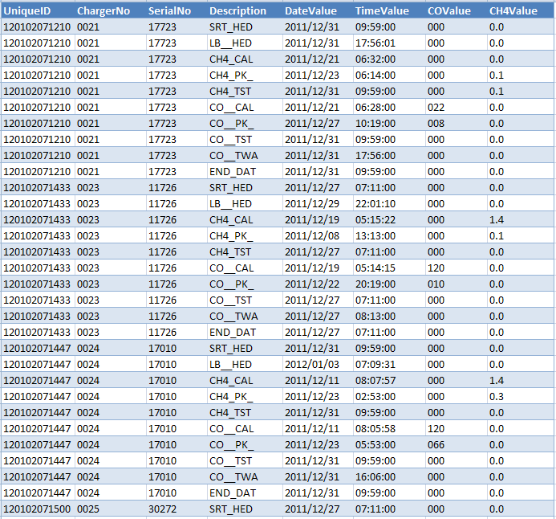
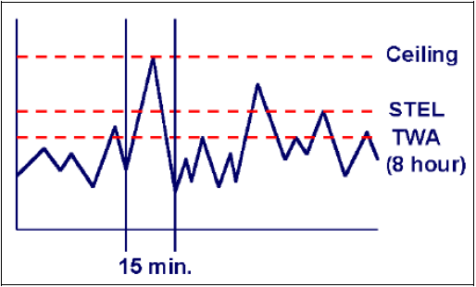
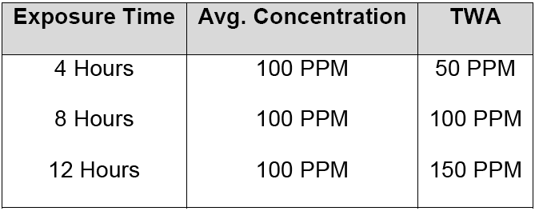
Gas detection optimised

Slide 9
Legislated Limits for CO
The Occupational Safety and Health Administration (OSHA)
35 parts of the gas per million parts of air (ppm), averaged over an 8-hour workday. There is also a ceiling limit of 200 ppm (as measured over a 15-minute period).
American Conference of Governmental Industrial Hygienists (ACGIH)
A TLV-TWA of 25 ppm, this value is intended to maintain blood COHb levels below 3.5%, to minimize the potential for adverse neurobehavioral changes, and to maintain cardiovascular work and exercise capacities. The recommended TLV should also provide a margin of safety for individuals particularly susceptible to the adverse effects of CO exposure, including pregnant employees and those with chronic heart and respiratory diseases.
South African Mine Health and Safety Act (29/1996)
OEL-TWA, 30 ppm (35 mg/m3). OEL-C1, 100 ppm (115 mg/m3).
1 OEL-C (OEL-Ceiling) means an instantaneous value which must never be exceeded during any part of the working exposure
Occupational Health and Safety Act
Biological monitoring provides one means to assess exposure and health risk to workers. It entails measurement of the concentration of a chemical determinant in the biological media of those exposed and is an indicator of the uptake of a substance
Determinant. carboxyhemoglobin in blood 8 % of hemoglobin, CO in end exhaled air

Slide 10
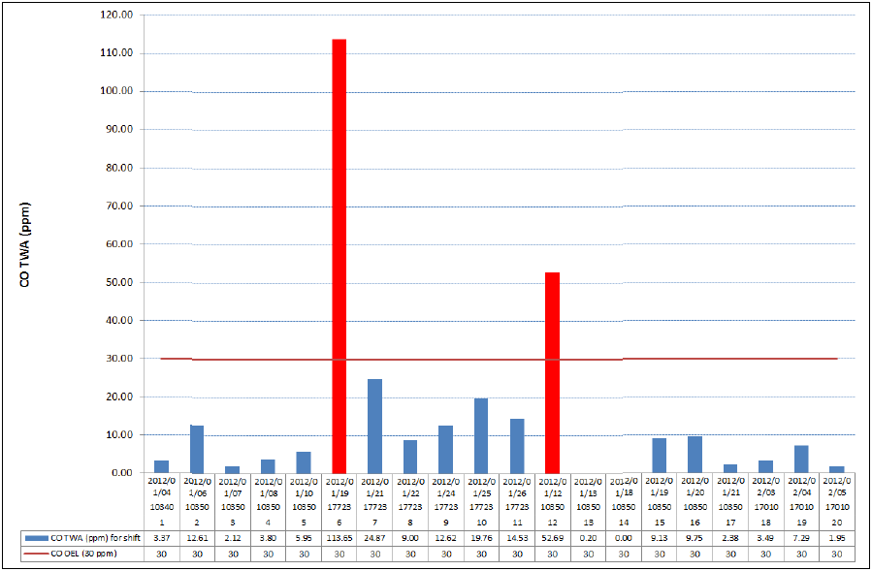
Gas detection optimised – Personal gas monitoring

Slide 11
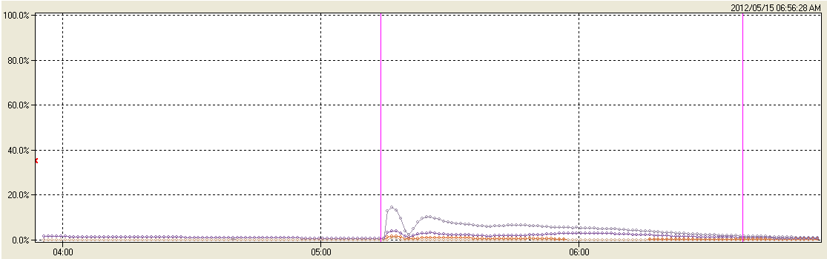
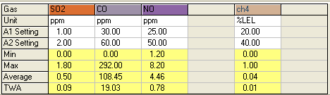
Gas exposure – post blasting (5E Pnl1)
CO = 292ppm
NO = 7.9ppm
SO2 = 1.8ppm

Slide 12
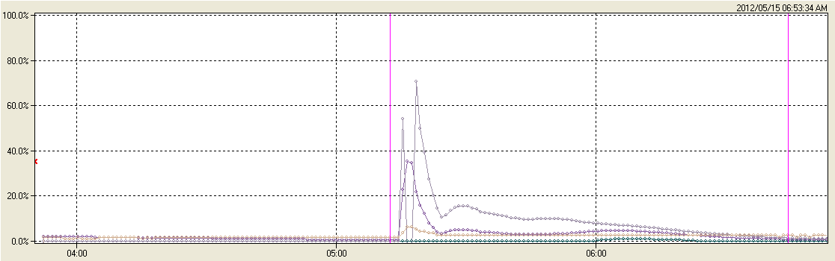
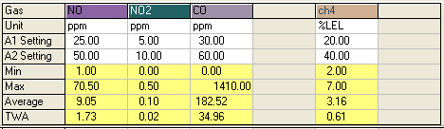
Gas exposure – post blasting (6E return)
CO = 1410pm
NO2 = 0.5ppm
NO = 70.5ppm

Slide 13
Gassings? Interpretation of Exposures allowing decision on gassing or suspected gassing
Chapter 23 of the MHSA Schedule 23.1, Reporting of Accidents and Dangerous
Occurrences states the following: Accidents to be reported
The employer must report to the PI any accident at the mine that results in:
The death of an employee;
An injury, to an employee, likely to be fatal;
Unconsciousness incapacitation from heatstroke or heat exhaustion, oxygen deficiency,
the inhalation of fumes or poisonous gas, or electric shock or electric burn or by any employee and which is not reportable in terms of paragraph (d);
NB – it is important to note that a gassing is not defined in the Mine Health and Safety Act, Act 29 of 1996 [MHSA].

Slide 14
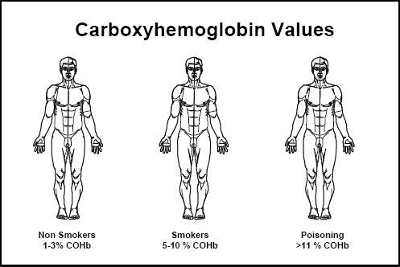
Definition of “Gassing” or potential over exposure
Poisoning by irrespirable or otherwise noxious gases. (noun - medical dictionary)
Noxious – Harmful to living things, injurious to health
A central concept of toxicology is that effects are dose-dependent (LD50)

Slide 15
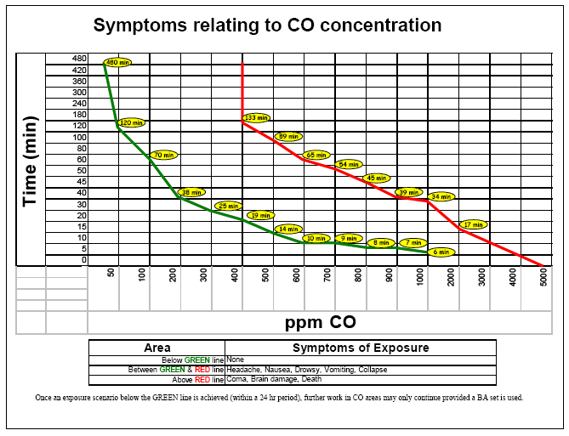

Slide 16
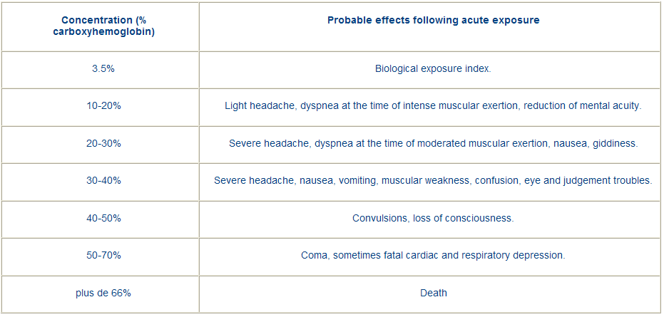
Definition of “Gassing” or potential over exposure
T able 1 shows approximate times required at various exposure levels to reach a COHb level of 3.5%, where there were no other CO exposure during the work day.
Table 1 shows approximate times required at various exposure levels to reach a COHb level of 3.5%, where there were no other CO exposure during the work day.

Slide 17
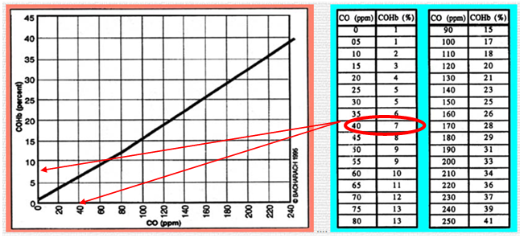
Relationship Expired CO to COHB%

Slide 18
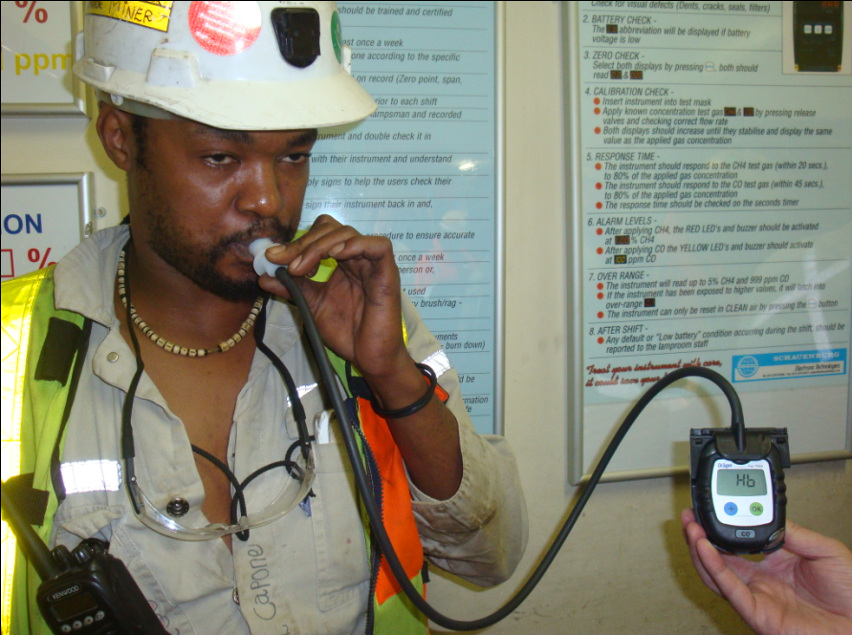
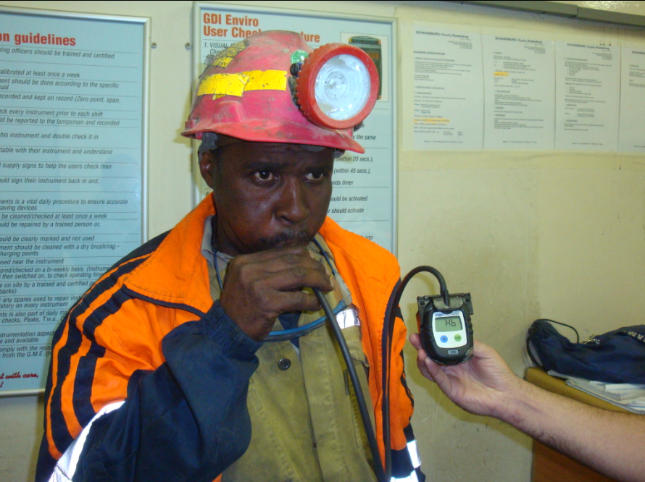
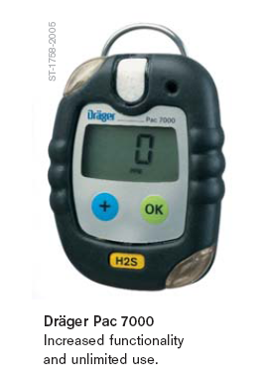
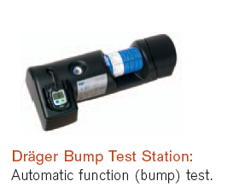

Slide 19
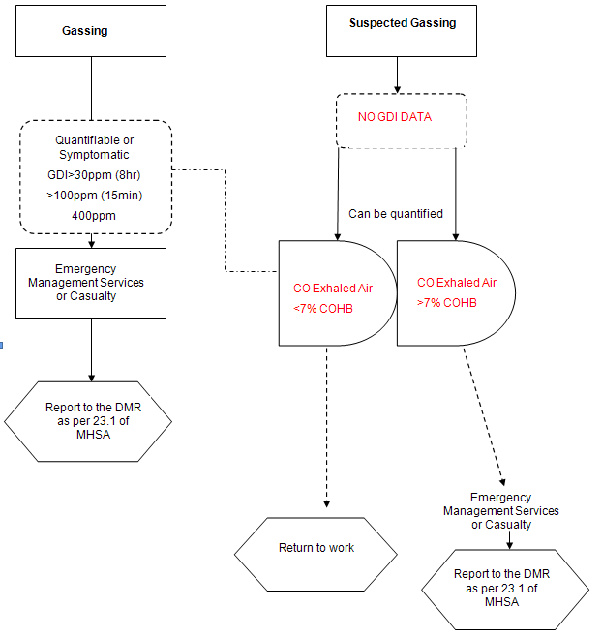

Slide 20
Criteria for hospital admission
COHb levels of 25% or more; over 15% in patient with history of cardiac or pulmonary disease, or impaired metabolism; over 10% in a pregnant woman (COHb level should be obtained as early as possible, and extrapolated back to time of termination based on COHb half-life, considering amount of O₂ given, level of activity, etc.
Abnormal ECG and/or coronary ischemic-type chest pain
Metabolic acidosis
Inability to maintain normal body temperature
Abnormal neuropsychologic examination
Decreased arterial oxygen content; decreased arterial PO₂ more serious
Myoglobinuria and/or abnormal renal function
Hyperglycemia (combined with other abnormalities)
Leukocytosis (combined with other abnormalities)
Elevated serum creatine phosphokinase (CK) and lactate dehydrogenase (LH)
History of unconsciousness

Slide 21
QUESTIONS

